Slide 1

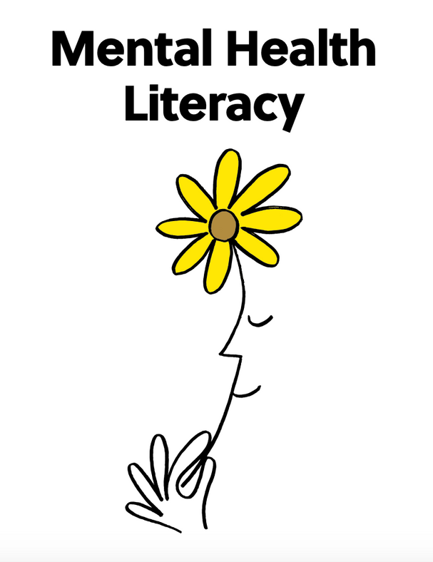
GRADES 9-12

Slide 2


Lesson PowerPoint Table of Contents​
Lesson 1:
The Road to Mental Health Literacy
Lesson 2:
The Road to Optimal Mental Health
Slides 3-12
  Mental Health Literacy
  Empowering Yourself
  Learning From Others
Slides 13-29
  Optimal Health and Well-being
  Factors of Optimal Health
  Analyzing Your Well-Being
  Taking Action
Lesson 3:
Understanding Stress Response
Lesson 4:
Understanding Language
Slides 30-44
  Understanding Stress Response
  Cognitive Distortions
  False Stress
Slides 45-65
  Words Are Powerful
  Talking "to" and Talking "at"
  Negative and Positive Phrases
  Defining Emotions
  The Stigma Around Mental Health

Slide 3

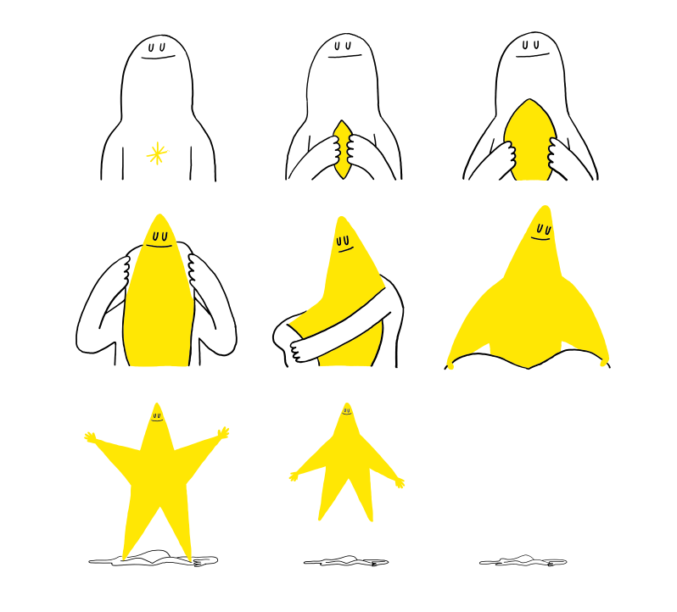


Slide 4

Part 1: Investigate and Learn
Mental Health
Mental Health Literacy

Slide 5

Mental Health Literacy
Video: Mental Health Literacy

Slide 6
Mental Health Literacy Can....
  Help us understand mental health, why it's important, factors that promote mental health and factors that can lead to mental health problems or disorders.
  Help us understand how to promote and maintain good mental health.
  Help us understand mental disorders and their treatments.
  Reduce stigma.
  Help us to care for others and ourselves, so we know what to do and what not to do.
  Help us increase self-efficacy and self-advocacy (voicing what we need to do to support our own good mental health).

Slide 7
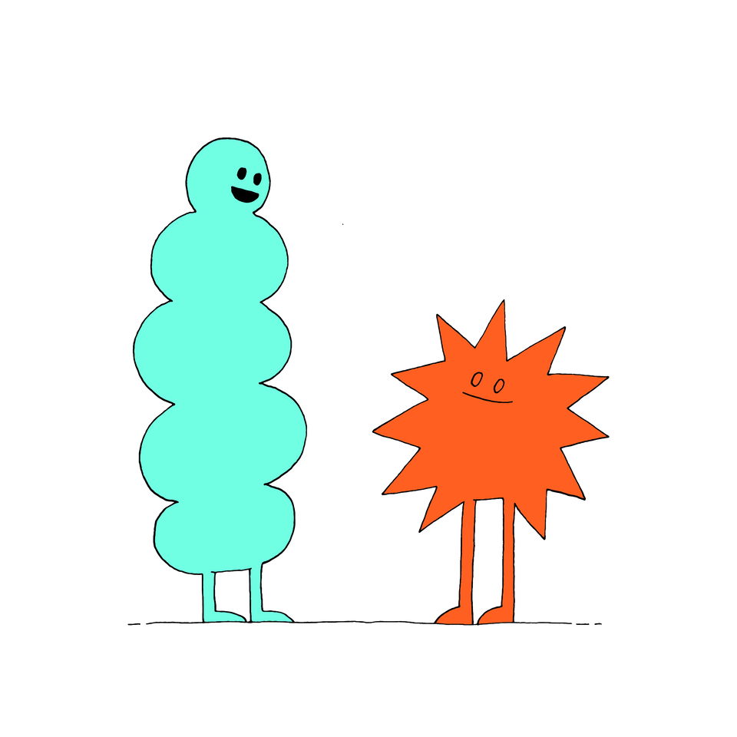
Mental Health Literacy is......
  What is something that stood out to you from the video with Dr. Kutcher?
  What is something new that you learned?
  Why do you personally think mental health literacy is important?
Turn and Talk

Slide 8
Mental Health Literacy continued
 | Understand how to obtain and maintain good mental health | Understand mental disorders and their treatment | Decrease stigma | Support with help-seeking efficacy (asking for help when we need it)
How can we practice this as a class?
How can we practice this individually?
Who are some of the people in our communities that we could share this information with?
What are some factors we would need to consider?

Slide 9


Part 2: Application
How can students empower themselves to share the importance of mental health literacy with others?

Slide 10
Role Playing
Practice what you'd say...
With your group come up with facts, questions or conversation starters. Try some of these:
Did you know that in the United States that almost half of the adults will experience a mental illness during their lifetime?
Compare how the topic of mental health is addressed in school now with an older family member's experience.
Why do you think there is so much stigma around mental health problems?

Slide 11
Action
At Home
  Find some time this week to chat with someone about mental health literacy.
  Take notes on the experience, either during or after, to note any new ideas or learnings you found, interesting opinions, misconceptions or different perspectives.
  Remember age, culture or experiences with their own mental health may affect their understanding or opinion.

Slide 12

Reflection
• Who did you talk to about mental health literacy?
• How did it feel to bring up the topic?
• What kinds of questions did you ask?
• Did your conversation partner share anything that surprised you?
• What did you find most interesting about the conversation?
• Why do you think it’s important to discuss mental health with the
people in our lives?

Slide 13




Slide 14
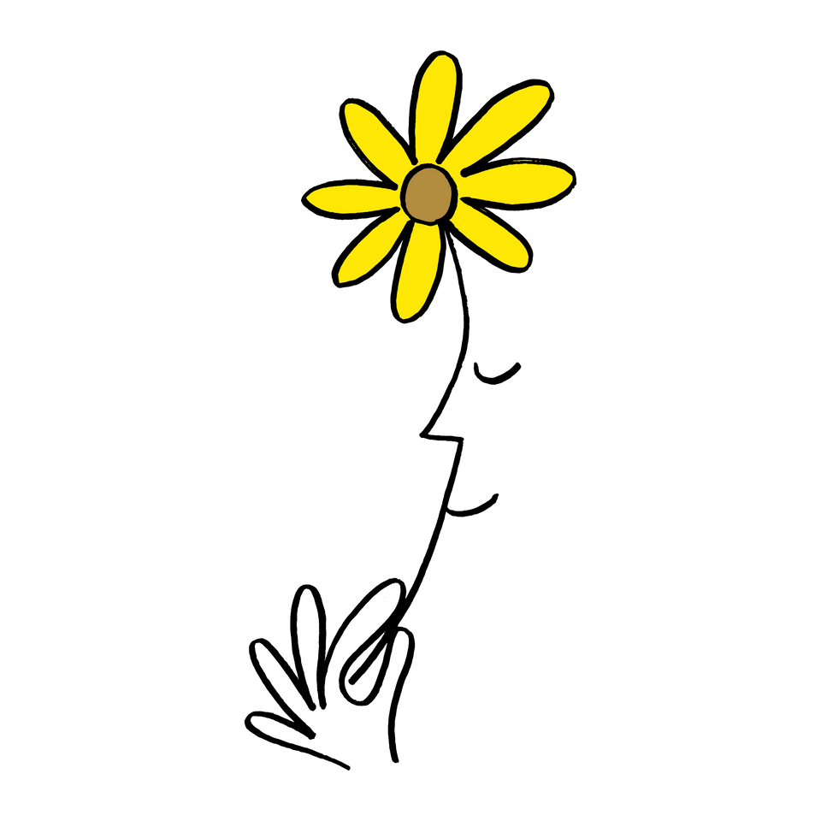
Part 1: Investigate and Learn
Talk Time
With your group discuss:
  What do you think it means to "optimize our mental health?"
  Why is it important?
  What are some practices you believe would be helpful for optimizing mental health?

Slide 15
Optimal Mental Health Well-being
Video: 5 Things for Optimal Mental Health Well-being

Slide 16
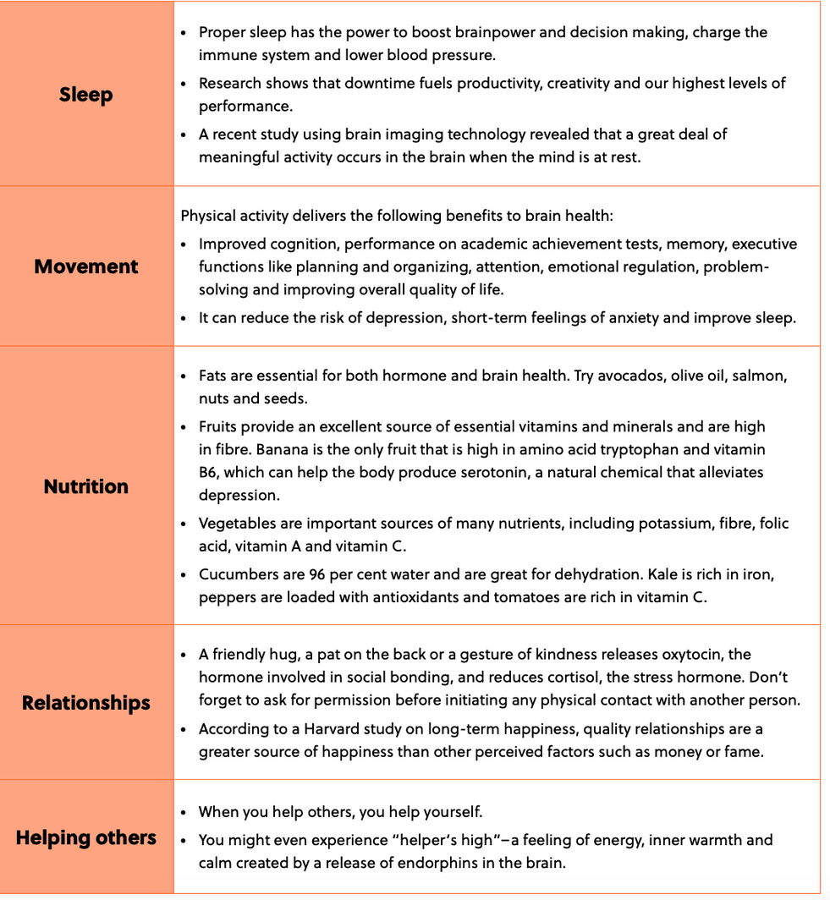
5 Things For Optimal Mental Health Well-being

Slide 17

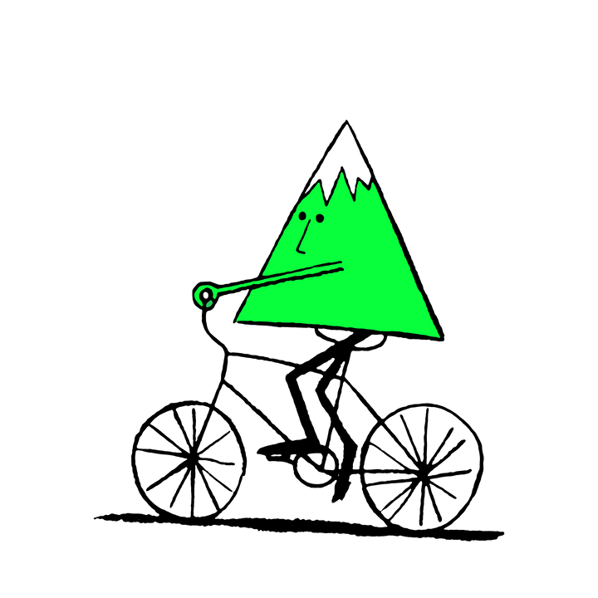
Factors of Optimal Mental Health
Get Up and Move
After I read each statement stand by the word that best represents your answer.

Slide 18
Factors of Optimal Mental Health
Get Up and Move
Which of the 5 things do
you personally think is the most important?

Slide 19
Factors of Optimal Mental Health
Get Up and Move
Which of the 5 things do
you think is the most challenging for students?

Slide 20
Factors of Optimal Mental Health
Get Up and Move
Which of the 5 things would you personally like
to improve on?

Slide 21


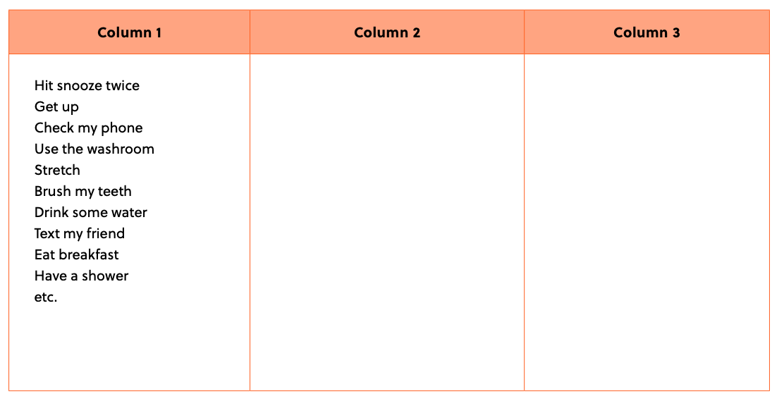
Part 2: Application
A Typical Day

Slide 22
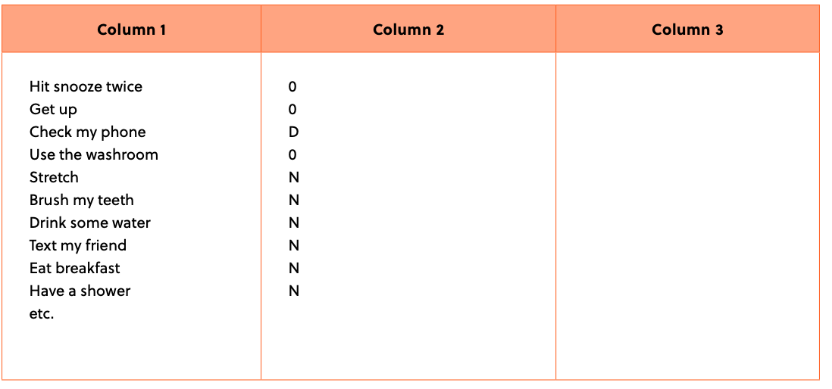
Part 2: Application continued
Categorizing

Slide 23
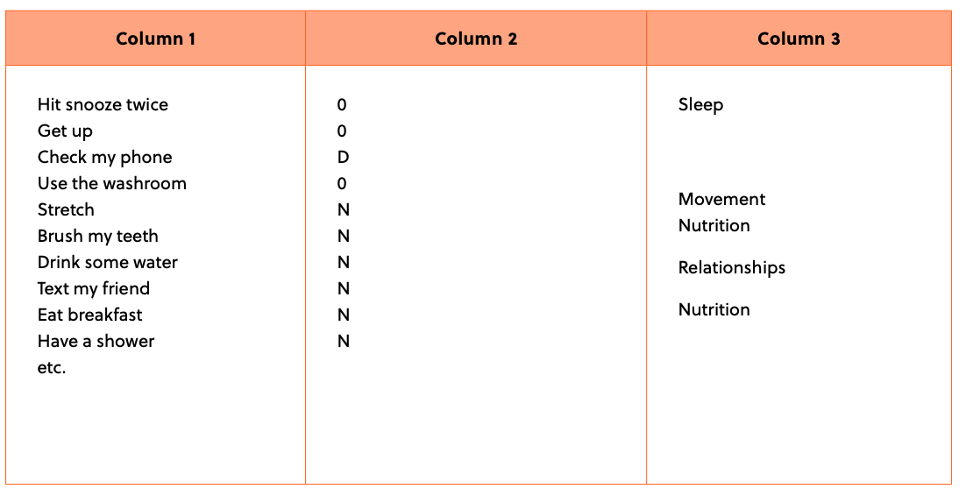
Part 2: Application continued
5 Things

Slide 24

Reflection
• What does it feel like when your stamina is close to empty?
• What does it feel like when your stamina is close to full?
• How did it feel to reflect on the things that replenish and drain
our stamina (well-being)?
• Did you find anything surprising when you looked at what nourished
or depleted you in your daily activity list?
• Why do you think it’s important to regularly do things that replenish your energy/stamina?
• What is one simple action you want to take this week to practice habits that can optimize
your well-being?
• How can you measure or track this new habit to keep yourself accountable and reflect on how you feel?

Slide 25
Part 3: Action
  What is the one action you would like to take this week
  to practice habits to optimize your well-being?
  What are some tips/tricks that you can do to remember?
Turn and Talk

Slide 26
Tips and Tricks
Set your alarm for the same time every morning. Reduce blue light and screens before bed. Try stretching or reading before bed. Use an app to help track the amount of water you drink. Pack a healthy snack for school the night before. | Try out a new healthy recipe with your family. Try stretching in the morning before getting ready. Take a daily walk. Try an exercise or yoga video. Plan to play a sport this week with a friend. Raise money for a cause you care about. | Leave someone a note to let them know you’re thinking about them. Call someone you haven’t spoken to in a while. Journal about someone or an experience you’re grateful for. Show your appreciation to community (or school community) workers. Volunteer for an after-school initiative.

Slide 27
Part 4: Reflect
Independent Writing
  What new practice did you try out?
  What did you find changing?
  What surprised you about the experience?
  Did you notice any changes after practicing your habit?
  Why do you think it's important to be mindful about how habits and practices can affect our mental health?

Slide 28




Slide 29
Part 1: Investigate and Learn
Independent Writing
  How would you describe stress?
  What does it feel like?
  How does your body respond to stress?
  How does your thinking respond to stress?

Slide 30
Understanding Stress Response
Video: Understanding Stress Response

Slide 31
Understanding Stress Response Continued
Talk Time
With your group discuss:
  What is stress?
  Why is stress normal and what is it telling us?
  What did you find surprising or interesting about Dr. Kutcher's take on stress?
  Why do we need to be mindful about how we speak about stress?
  What approach is important in managing stress?

Slide 32

Conclusions About Stress Response
• Stress response is your emotional, cognitive and physiological change to your environment.
• Stress should not be observed as negative but as
a positive indicator that an appropriate response
is needed.
• Stress is a positive challenge and an opportunity
to grow or develop new skill sets.

Slide 33
Conclusions About Stress Response
• Our personal perspective and experiences can shape how
we see and respond to stress.
• Using appropriate language is key in reframing a stressful
incident.
• How we speak about stress to others can either be
debilitating or supportive.
• It is important to strategically respond and develop
needed skills to manage stress.

Slide 34
Part 2: Application
Video: Fight, Flight, and Freeze Response

Slide 35
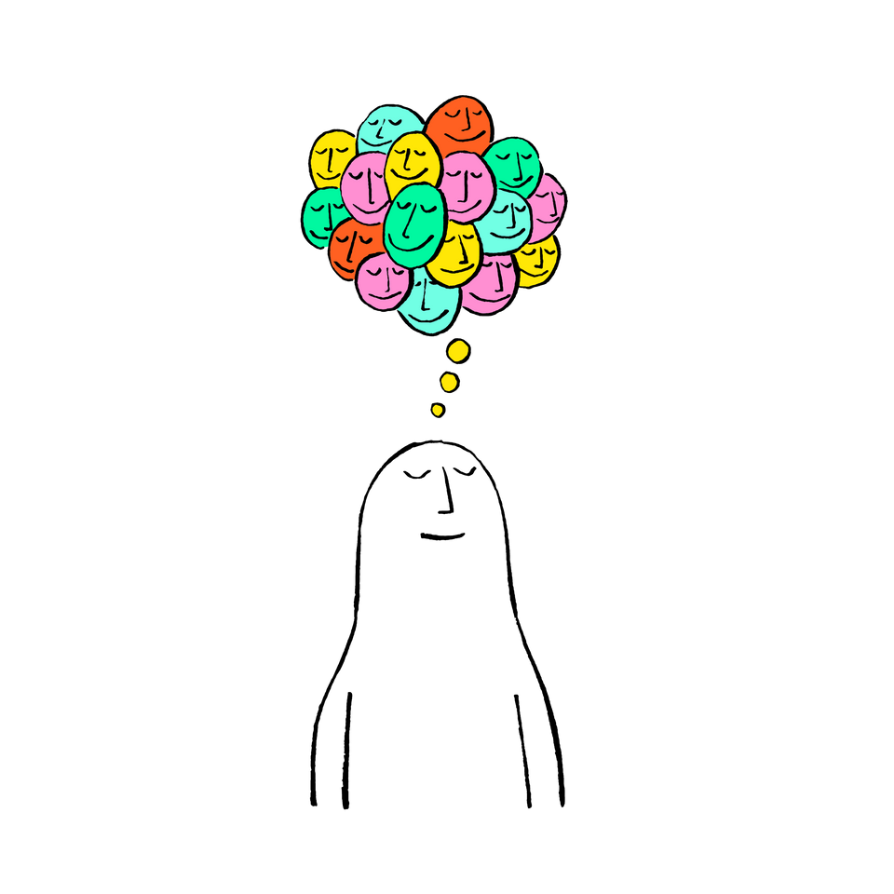
Video Recap
Our body and mind prepare us to react to stress.
False stress responses mean that you perceived a situation to be stressful or threatening however in retrospect, it was not that threatening.

Slide 36
Cognitive Distortions
Video: How to Stop Distortions

Slide 37
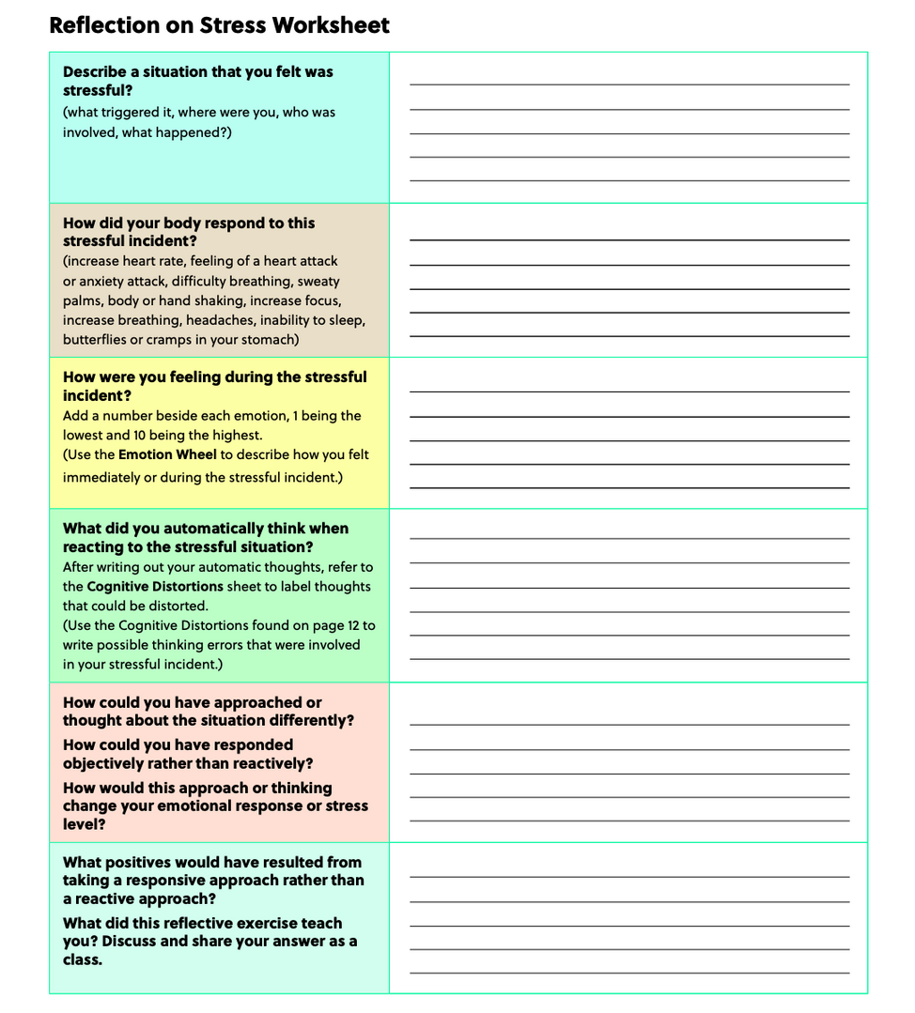
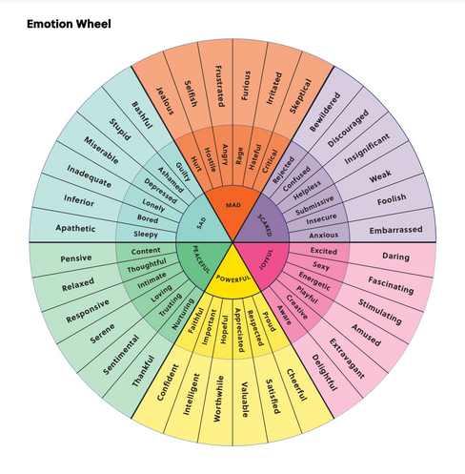
False Stress
Think of an experience which can be described as a “false stress” and answer the following questions.

Slide 38
Reflecting on Stressful Responses
Talk Time
With your group discuss:
  What did this reflective exercise tell you?
  What was challenging when completing it? What further information is needed to overcome these challenges?
  How can we use this reflective exercise in managing future stressful incidents?

Slide 39
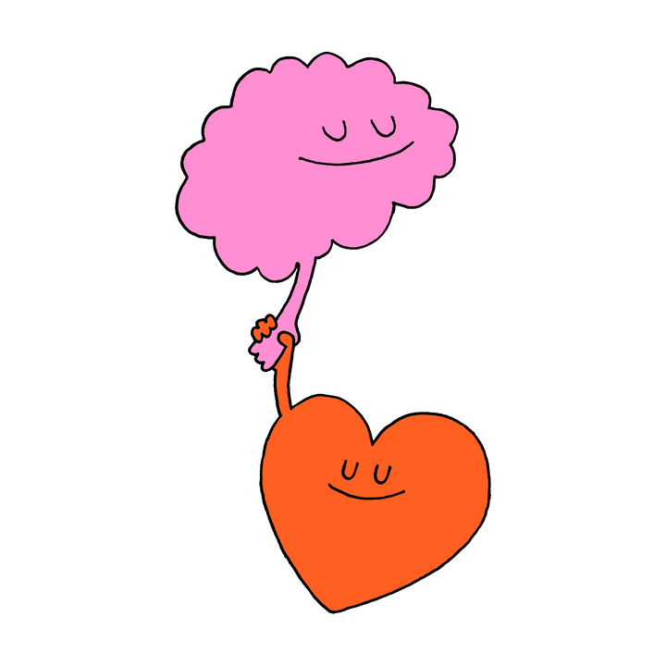
Conclusions About Stress Response
  We tend to overreact to stressful incidents which can exacerbate the situation and create further unnecessary stress.
  Our thinking affects our emotions and how we react to stressful situations.
  By changing how we think, we can change how we feel and respond to stress.
  We can build our stress response management skills by pausing and allowing time to think, in order to change how we feel and how we choose to respond—this skill can be developed by using the stress worksheet provided in this lesson.

Slide 40
Conclusions About Stress Response
  We can build our stress response management skills by pausing and allowing time to think, in order to change how we feel and how we choose to respond—this skill can be developed by using the stress worksheet provided in this lesson.
  Our negative thinking or cognitive distortions can impair our ability to appropriately respond to stress.
  There are always two perspectives to any situation.

Slide 41
Conclusions About Stress Response
  Sometimes healthy communications can reduce stress.
  Sometimes we cannot change the stressful incident but must accept it with a positive mindset.
  We can strengthen our stress response skills to stress rather than unconsciously reacting to stressful incidents.
  It is important to understand the difference between
“react” and “respond.” As human beings we all need
time to gather our emotions and thoughts before
we are ready to respond.

Slide 42
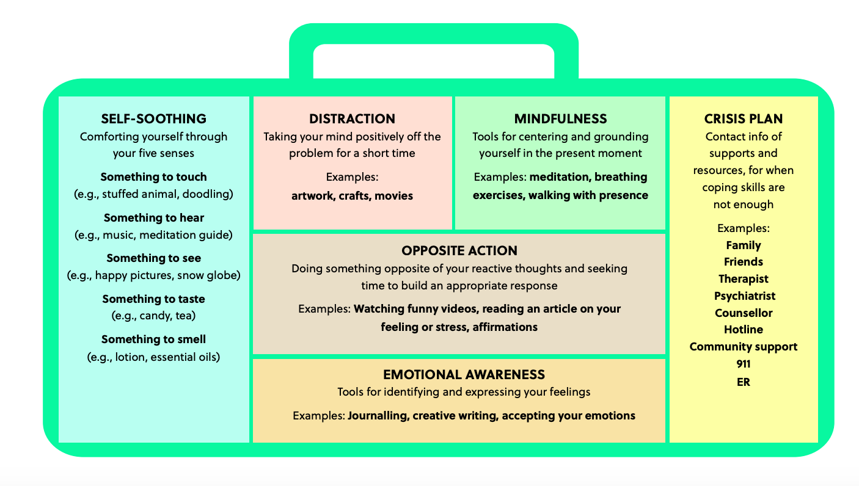
Part 3: Action
Coping Skills Toolbox

Slide 43



Slide 44


Part 1: Investigate and Learn
When I read a statement, draw an image to represent what is being communicated.

Slide 45
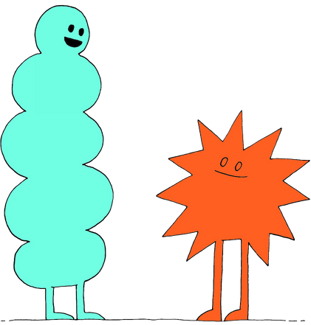
Words are Powerful
  What happened when one word was
  changed in the sentences?
  How can words change what we think or understand?
Turn and Talk

Slide 46
Understanding Language
Video: Your Words Matter: Mental Health vs. Mental Illness

Slide 47
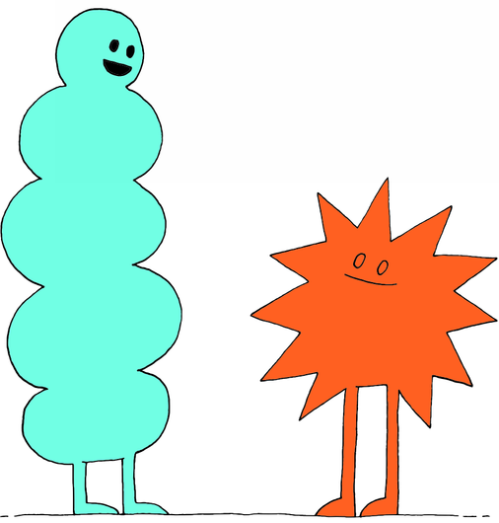
Discussion Question 1
What words, phrases or actions describe the act of “talking to” each other?

Slide 48
Conclusions
• Summarizing what is being communicated • Being present when someone is speaking • Listening before providing an opinion • Reflecting on what is being communicated | • Using non-verbal behavior such as making eye contact and keeping arms open • Using open ended questions • Asking questions for clarification | • Sharing your thoughts after asking for permission • Using “I” when expressing your thoughts • Being attuned to the person’s feelings • Being empathetic

Slide 49
Discussion Question 2
What words, phrases or actions describe the act of “talking past” each other?

Slide 50
Conclusions
• Giving your opinion without permission • Being judgmental • Pretending to listen • Being prejudiced • Jumping to Conclusions • Debating • Selective Listening | • Using defensive or closed non- verbal behavior such as being on your phone, looking elsewhere, closed arms • Using sentences starting with “You” to express your opinion • Being empathetic • Interrupting | • Derailing • staying silent with not non-verbal cues • Finishing the person’s sentence • Talking about your experience and making them feel less important • Correcting or undermining them

Slide 51
Distress or Opportunity
reframe into
Negative Phrases
Positive Phrases

Slide 52
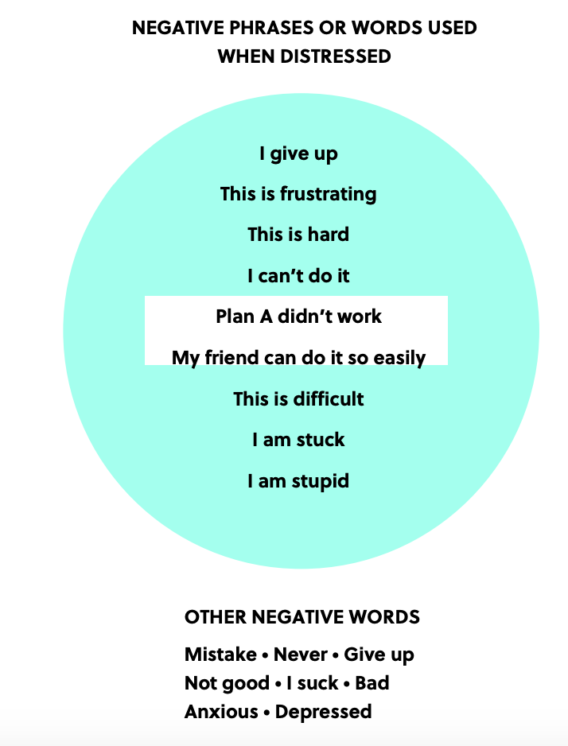
Negative Phrases

Slide 53
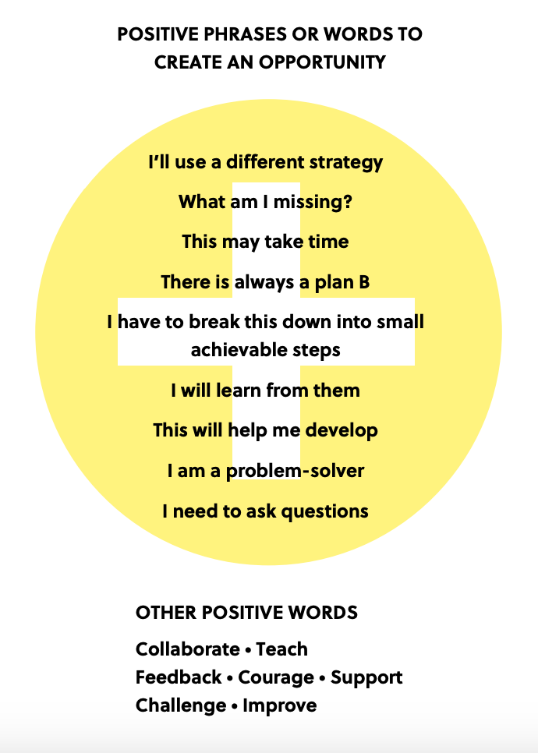
Positive Phrases

Slide 54
Growth vs. Fixed Mindset
Words or phrases that promote growth mindset
will reframe a situation as an opportunity.
Words or phrases that generate a fixed mindset
will reframe situations as distressed.

Slide 55

Part 2: Application
Class Discussion
  One person will read a word.
  Everyone will write or draw their response.
  Share if you want to.
  The person to the right of the reader, will read the next word and the process will continue.

Slide 56
Defining Emotions
With your group answer the questions:
  What is the difference between angry and frustrated?
  What is the difference between loved and happy?
  What is the difference between anxious and worried?
Talk Time

Slide 57
Defining Emotions Continued
Class Definitions:
frus·tra·tion /frəˈstrāSHən/
loved /ləvd/
an·ger
/ˈaNGɡər/

Slide 58
Defining Emotions Continued
Class Definitions:
anx·ious /ˈaNG(k)SHəs/
wor·ried /ˈwərēd/
hap·py
/ˈhapē/

Slide 59
Clarifying Emotions
Anger: A reaction to a stimulus which results in being antagonistic toward someone. A reaction to a feeling that something deliberately did you wrong. Anger is often a reaction to an underlying emotion such as frustration, sadness, etc. | Frustration: A feeling of disappointment when an effort or observation does not work out as expected or anticipated. | Anxious: An intense feeling of unease, worry and fear. A feeling causing trouble in concentration, avoiding situations or people, irrational fear of things or situations, irritability, fatigue, sweatiness, dizziness, inability to sleep, difficulty in breathing, and chest pains or heart palpitations.
Happy: A temporary feeling of contentment or pleasure. | Worried: A state of concern or disturbance from care. | Loved: A strong feeling of affection without any expectations, jealousy, force or misunderstanding.

Slide 60
Reflecting
  Why is it important to use appropriate words to a describe a situation so we can communicate a shared understanding?
  Why is it important to ask for clarification when someone is expressing their feelings or thoughts?
  Why is it harmful to assume what someone is saying?
Turn and Talk

Slide 61
Part 3: Action
Video: Your Words Matter – The Stigma Around Mental Health

Slide 62
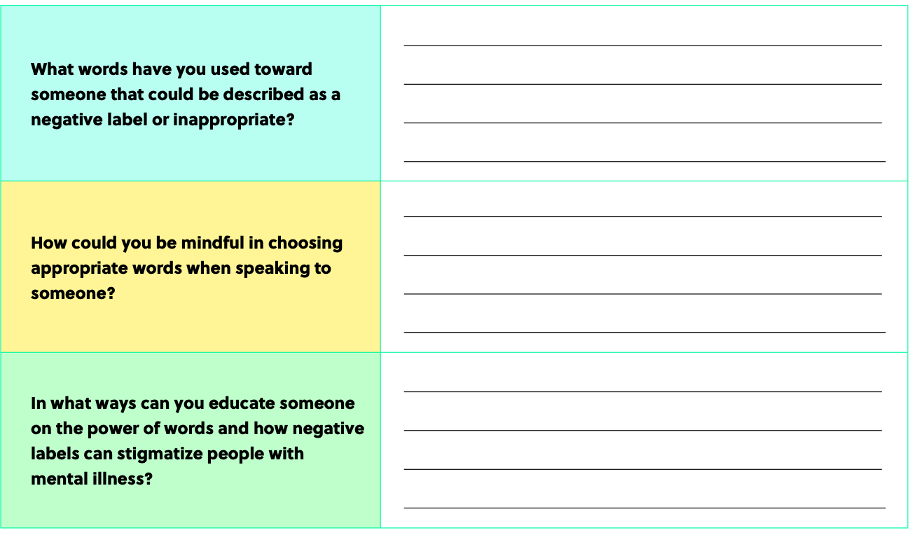
Reflections

Slide 63


Thank You!

