Slide 1



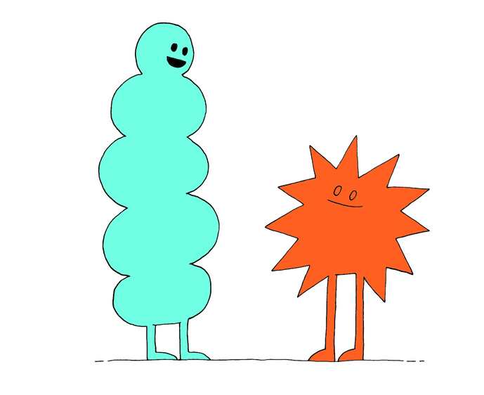

Slide 2
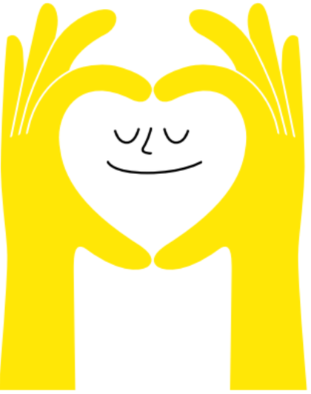
Lesson PowerPoint Table of Contents
Lesson 1:
The Many Forms of Relationships
Lesson 2:
Communicating Core Values
Slides 3-16
  Positive Relationships
  People We Know
  Healthy Relationships
Slides 17-30
  Strong Communication Skills
  Relationship Violence
  Safety Plan
Lesson 3:
Setting Up Healthy Boundaries
Lesson 4:
Dealing With Rejection
Slides 31-40
  Reviewing Relationships
  Boundaries
  Assertive Communication Style
  Linking Boundaries to Values
Slides 41-46
  Rejection
  Responding to Rejection
  What Can We Learn From Rejection?
Lesson 5: Understanding Healthy Relationships
Slides 47-57
• Changing Relationships • Let’s Review • Engaging in Meaningful Relationships • Action Plan •Celebration
Notes:
2

Slide 3





Slide 4
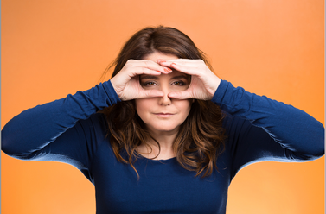

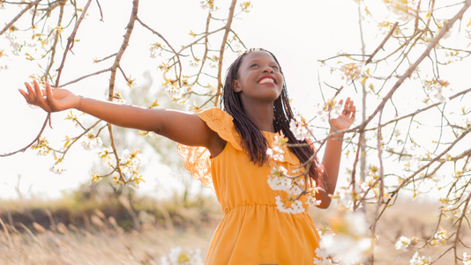
Positive Relationships
Walk-about: Go to each station and think about what each word:
Looks like
Sounds like
Feels like

Slide 5

Positive Relationships Continued
With your group:
Discuss and define the following fundamental relationship qualities
  Mutual respect
  Admiration for one another
  Trust in turning towards each other
  Balance of power
  Team problem solving
  Safe and open communication

Slide 6
Definitions
Mutual Respect: Seeing both individuals as valuable and contributors of the relationship, understanding each other with effort and patience, keeping each other in mind when making decisions, understanding and being considerate of each other’s wants and needs, etc. | Admiration: Respecting each other’s interests, strengths and uniqueness, allowing room for growth and support, expressing your admiration, respecting how the other person interacts with their loved ones and their community, respecting what they stand for, etc. | Trust in Turning Towards Each Other: Understanding that disagreements or misunderstandings are natural in every relationship, seeking clarification and a goal to understand each other better, feeling safe and respected in sharing one’s feelings and thoughts, etc.
Balance of Power: Having a fair and shared sense of support, feeling safe and comfortable in making good decisions together, being able to discuss any imbalances, feeling safe to end a relationship as a compassionate choice, being able to have healthy financial discussions, etc. | Team Problem Solving: Understanding that every relationship has challenges, working together to find solutions to challenges, finding ways to better understand each other’s emotions, feelings and thoughts, finding solutions that both individuals feel comfortable and safe with, being able to rely on each other when facing a challenge, etc. | Safe and Open Communication: Understanding and continuously developing our communication skills, feeling safe in expressing thoughts, feelings and emotions to one another, being respected when communicating, actively listening, being nonjudgmental, etc.
Now rank the order of importance of each quality.
Notes:
Teacher Note: A printable version of this sheet can be found in the lesson package
6

Slide 7

People We Know
Brainstorm:
Write down as many names of people you know.
Timer
Notes:
7

Slide 8
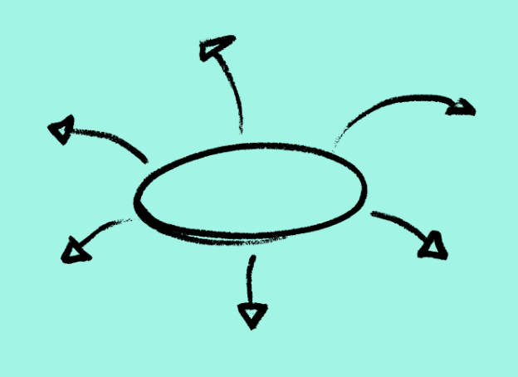
Categorizing Groups In Your Life
classmates
friends
family
mentors
teachers
How are they similar? How are they different?
Notes:
Teacher notes: There is a printable version of this bubble map in our Well-Being Canada resources, so you can…
- Print the web out and have your students complete this independently first
- Print the web out and have students complete in partners or small groups first
- Project the web on your board and complete together as a class
The following slide shows sample answers so your class can compare your answers with ours!
8

Slide 9
Changing Relationships
Talk Time
With your group discuss:
  How do relationships change over time?
  What factors may change relationships after middle school, high school and graduation?
Notes:
Teacher Note: A printable version of this sheet can be found in the lesson package
9

Slide 10

How to Maintain Friendships
Video: Guide to Maintaining Friendships
Notes:
10

Slide 11
Friendships
Take a moment to think about your good friend.
  How was the friendship created?
  Has the friendship changed over time? How?
  What can maintain or strengthen this friendship?
Think-Pair-Share
  Why do we enter relationships?
  What makes a relationship that you choose like your friends different from those you don't choose like your family?
Notes:
11

Slide 12
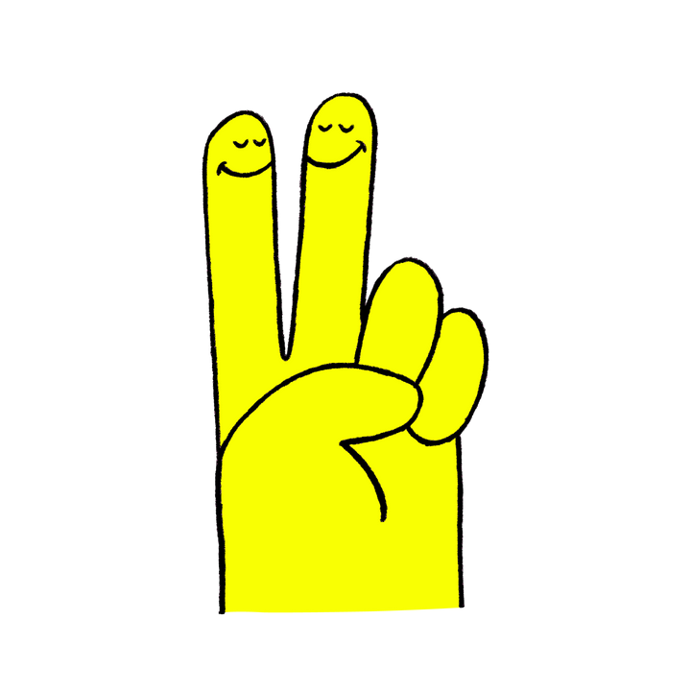
Healthy Relationships Can...
  provide comfort and joy in difficult or happy moments
  help develop social skills
  provide us with important and honest feedback
  Help develop social skills towards having a romantic relationship
  improve well-being and longevity
Clear expectations are key to a healthy relationship
Notes:
12

Slide 13
Healthy Relationships Continued
FRIENDS
STRANGERS
Notes:
Teacher Note: A printable version of this sheet can be found in the lesson package
13

Slide 14
Relationship Expectations
  What characteristics or personality traits can you bring to a friendship?
  What characteristics or personality traits are you looking for in a friend?
  What characteristics would you like to avoid in a friend or relationship?
Each person is different and will have different wants, needs and expectations from a relationship.
Notes:
14

Slide 15
Healthy Relationship = Fair and Balanced
Do you think the relationship is fair and balanced?
Scenario 1
Scenario 2
Scenario 3
Darnell and Molly hand out after school most days. They usually spend time at Darnell's home. Molly often suggests different activities or hanging out with her friends. Darnell says he prefers hanging out at his house, so they can only play games on his latest gaming device.
Alice and Aleysha like going to the movies. When they go together, they take turns selecting which movie to watch. Aleysha does not like certain movies due to her beliefs and Alice is respectful and understanding of Aleysha's preferences.
Pablo and Zhang Wei have been dating for two months. Zhang Wei thinks it's fine that Pablo still hangs out with his close friends. However, Zhang Wei becomes visibly upset and ignores Pablo for days when she sees Pablo wearing lipstick to school.
Notes:
15

Slide 16
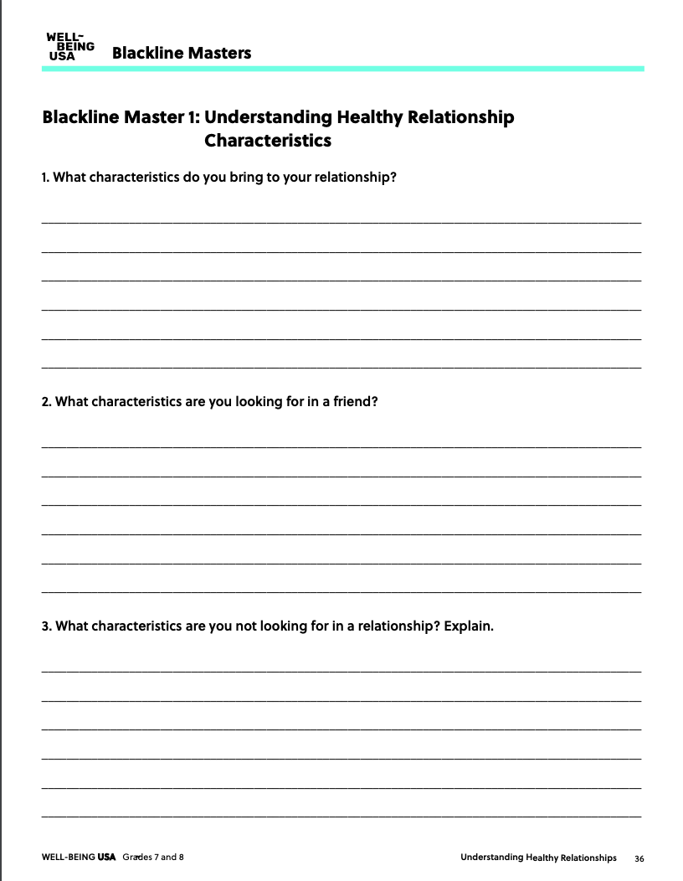

Understanding Healthy Relationship Characteristics
Take some time to think about your relationships and answer the questions.
Notes:
16

Slide 17

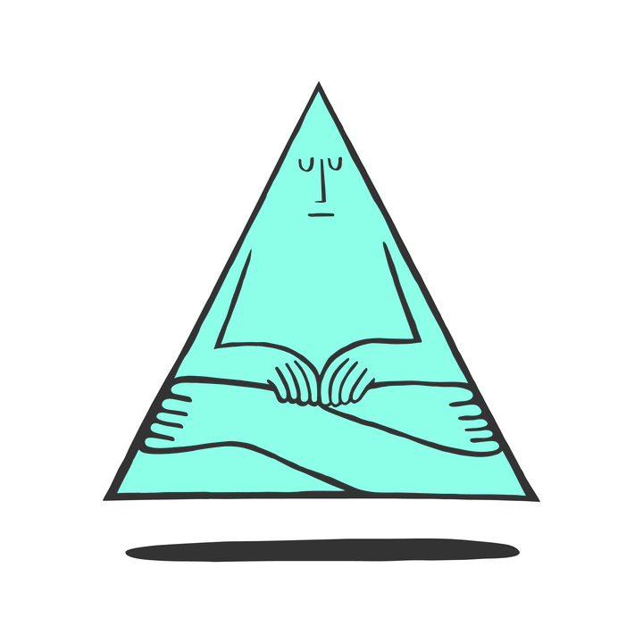
Reflection
What do you need or want in a relationship? Why?
How will you know when your need or want is met?
Notes:
17

Slide 18

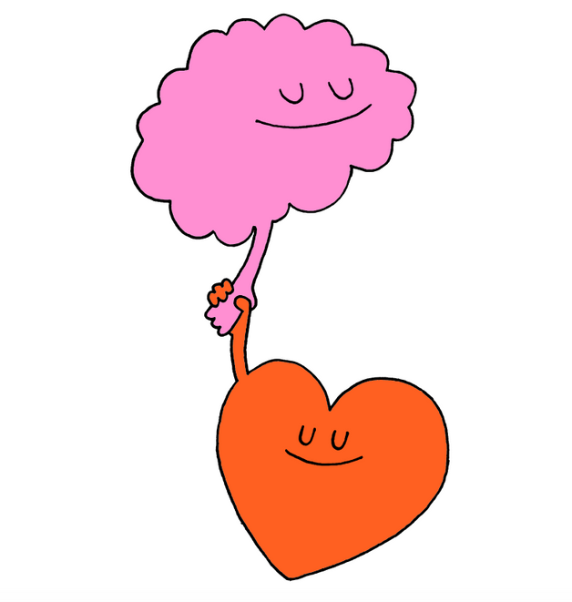


Slide 19
Communication Skills
Strong communication skills require a high level of self-awareness.
Understanding our personal communication styles will help create and maintain
positive relationships.
Think-Pair-Share
What does it mean to be a strong communicator?
Notes:
19

Slide 20
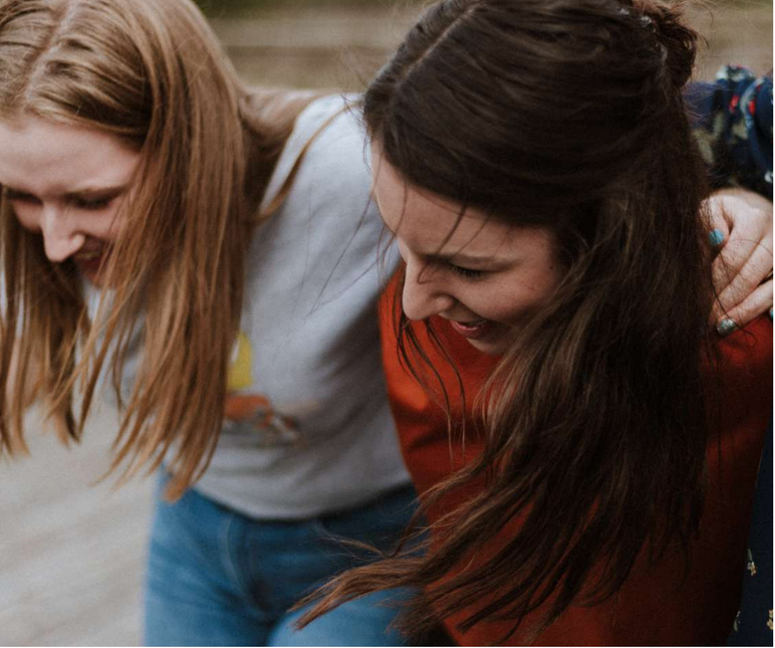
Four Styles of Communication
  passive
  passive-aggressive
  aggressive
  assertive
Share Out!
Ineffective communication styles are passive, passive-aggressive and aggressive. What do these sound like?
Notes:
20

Slide 21

Passive Communication
Passive phrases sound like
  "I don't care, you can choose."
  "Whatever you like."
  "It doesn't matter what I say or think."

Slide 22
Passive-Aggressive Communication
Passive-aggressive phrases sound like:
  "I am fine, but don't be surprised if I don't speak to you for a week."
  "We can do this your way, but it won't work because you don't know what you are talking about."
  "Why are you always over-reacting, I am just trying to help."

Slide 23
Aggressive Communication
Aggressive phrases
sound like
  "I am never wrong, so you better listen up."
  "Why are you so stupid, your opinion doesn't matter."
  "Fine, I'll get my way no matter what you do, just watch me."

Slide 24
Assertive Communication
Assertive phrases sound like
  "I would appreciate it if you would...."
  "How can we work this out?"
  "We both feel a certain way, but let's respectfully figure out a solution."

Slide 25
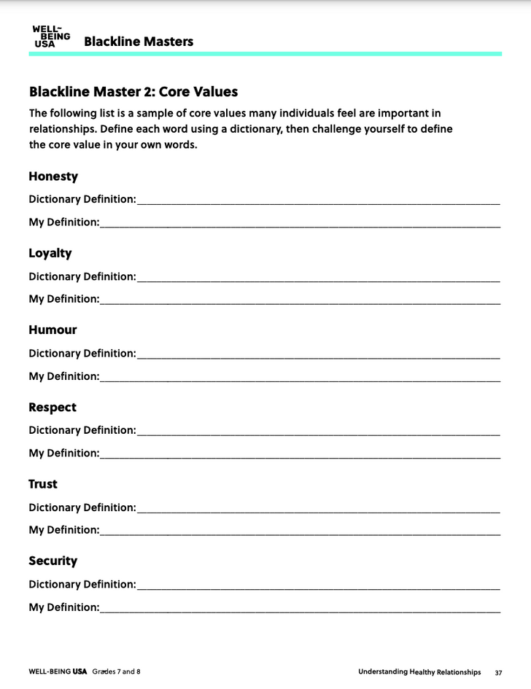
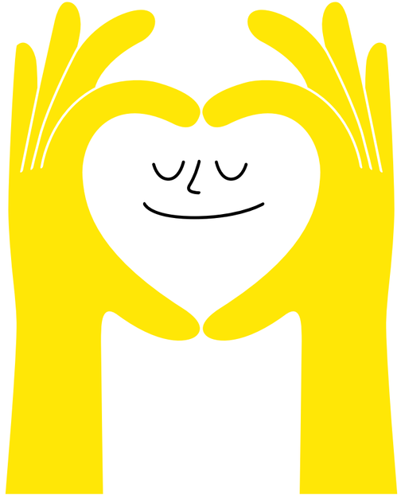
Core Values In A Relationship
Honesty
Loyalty
Humor
Trust
Respect
Security
Intelligence
Acceptance
Accessibility
Reliability
Notes:
25

Slide 26
Core Values
Put your sticky notes on the board.
1
2
3
Notes:
26

Slide 27
Role Playing
Get Creative
With your group:
  Create a role-play demonstrating how you communicate your core values to a friend, family member, classmate, teacher or significant other.
  Consider the words and body language that demonstrate your values and perspective.
Notes:
Teacher Note: A printable version of this sheet can be found in the lesson package
27

Slide 28
Reflection
If you could satisfy only one core value, which one would you choose and why?
Notes:
28

Slide 29
Relationship Violence
Talk Time
With your group:
  Share your response to the question: What is relationship violence?
  Create a group definition.
  Write the definition on the board.
Notes:
Teacher Note: A printable version of this sheet can be found in the lesson package
29

Slide 30
Warning Signs
Relationship Violence
Share your response to this question with your group:
  What is relationship violence?
  Create a group definition.
  Write the definition on the board.
Notes:
Teacher Note: A printable version of this sheet can be found in the lesson package
30

Slide 31
Teen Dating Violence PSA
Video: Teen Dating Violence
Notes:
31

Slide 32
Class Discussion
Relationship Violence
  Did the video change your perspective on the forms of relationship violence?
  Would you change or update the types identified in your definition?
  Why can relationship violence occur in any type of relationship, whether it be a friend, romantic or family relationship?
Notes:
Teacher Note: A printable version of this sheet can be found in the lesson package
32

Slide 33
Warning Signs Continued
A person's core values are disregarded by the person they are in a relationship with when emotional, mental or physical violence occurs.
With Your Group
  Create an infographic raising awareness about the common warning signs of an unhealthy relationship.
  Provide examples of how these can affect any type of relationship
  Suggestions for display are PowerPoint, Venngage or Bristol Board.
Notes:
Teacher Note: A printable version of this sheet can be found in the lesson package
33

Slide 34
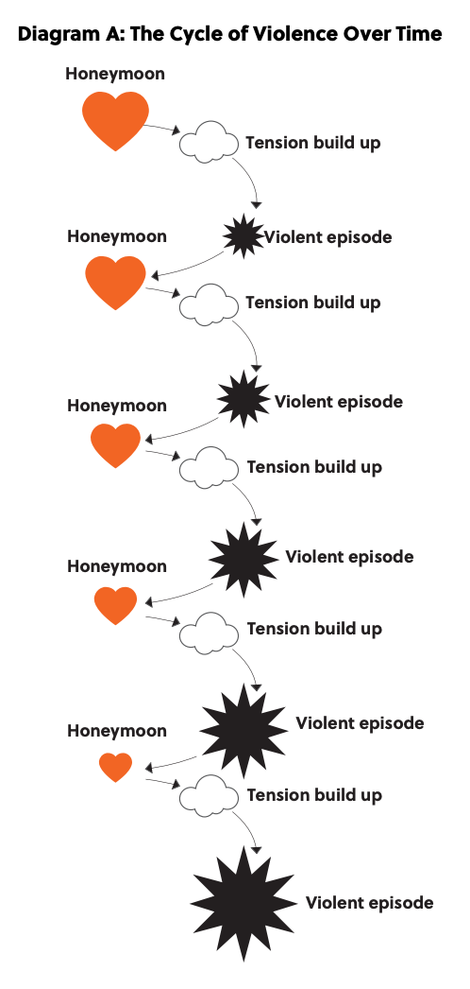
The Cycle of Relationship Violence
  Tension Build Up
  Violent Episodes
  Honeymoon
Notes:
Teacher Note: A printable version of this sheet can be found in the lesson package
34

Slide 35
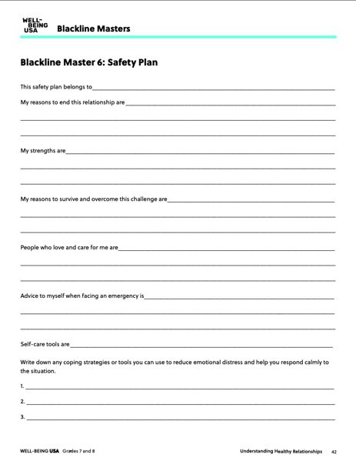
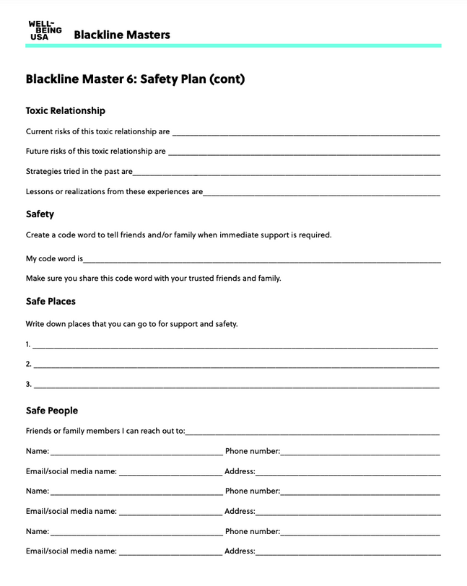
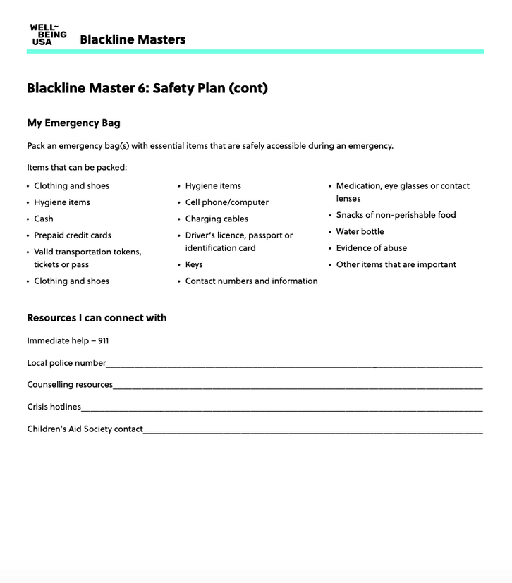
Safety Plan
You can make your own safety plan.
Notes:
Teacher Note: A printable version of this sheet can be found in the lesson package
35

Slide 36




Slide 37

Review - Relationships
Healthy
Notes:
Teacher Note: A printable version of this sheet can be found in the lesson package
37

Slide 38
Boundaries
  A divide that exists between two people
  A set of standards for interactions and relationships
Material
Time or Relational
Physical
lending or giving money or items
when you are available and for whom you are available
Personal space
Everyone's boundaries will be different. Boundaries and respect for differences help strengthen relationships.
Notes:
Teacher Note: A printable version of this sheet can be found in the lesson package
38

Slide 39
Healthy Boundaries
Talk Time
  Brainstorm the benefits of healthy boundaries.
  Search online for benefits of healthy boundaries and share your own experiences if you want.
  Discuss why it might be difficult to establish boundaries.
  Create a short video about how to effectively establish boundaries and why it's important in all relationships that boundaries are established an upheld.
Notes:
Teacher Note: A printable version of this sheet can be found in the lesson package
39

Slide 40
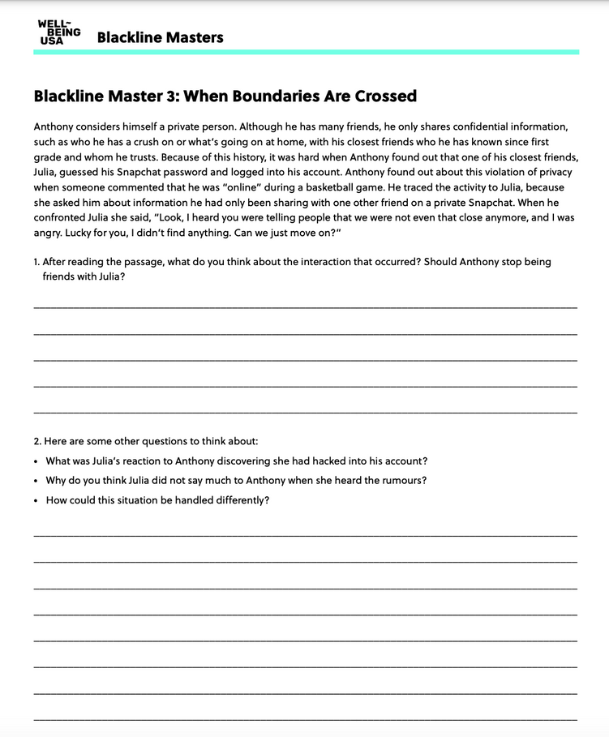
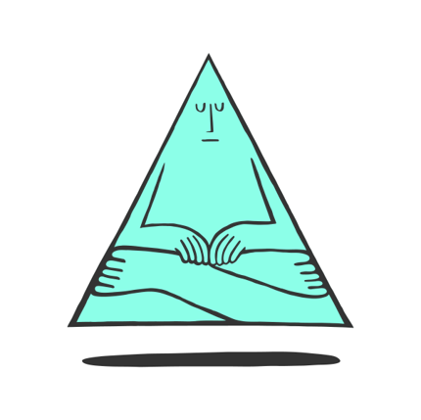
When Boundaries Are Crossed
You are your own best advocate. Don't be afraid to speak up!
In your group discuss:
  How the failure to set up boundaries can lead to misunderstandings between individuals in relationships and may cause conflicts
  Use examples from the case study to support your opinions
Notes:
Teacher Note: A printable version of this sheet can be found in the lesson package
40

Slide 41
Steps to Take When Boundaries Are Crossed
When you feel boundary violations or abuse is present:
Recognize the many forms of abuse: verbal, emotional, physical, psychological, sexual, financial, intimidation or threats, isolation and cyber bullying.
Don't blame yourself. Verbal abuse is real. It is important for you to remember that you didn't create a reason for the abuse regardless of how you communicated with your partner.
If you have a friend exhibiting abusive behaviors, suggest them to seek appropriate help and/or reflect or research the impact of their actions.
Ending a relationship is hard. You may feel you want to go back to the relationship. It's your decision, but remember, abusive patterns won't change unless a person gets help, and even still, the behavior might not stop.
If you are a victim, you are not responsible for "fixing" your partner.
Notes:
Teacher Note: A printable version of this sheet can be found in the lesson package
41

Slide 42
Reflection
Write a list of non-negotiables.
How would you respond if one of these is broken?
Notes:
42

Slide 43
Setting and Respecting Personal Boundaries
Follow-through is the most important part of setting and respecting personal boundaries.
Think-Pair-Share
If you were Sam, how would you respond in these situations:
  Sam walks into the school gym and a friend playfully tackles him. Sam doesn't like surprises and was hurt by the tackle.
  Sam tells a friend about troubles at home. This friend posts something on Sam's Facebook wall that mentions these troubles. Sam feels embarrassed with this type of public sharing.
  Sam must make up a test after school, but still wants to meet his friend for pizza. Sam gives them $10.00 for his share of pizza, knowing that it will only be $5.00. When Sam arrives and asks for change, his friend says they were running short and needed to use all the money he gave them.
Notes:
Teacher Note: A printable version of this sheet can be found in the lesson package
43

Slide 44
Assertive Communication Style
"I" statements:
  I feel ____________ when you _______________.
  Please ______________________.
  I am willing to ________________________.
  Please do not ____________________.
Notes:
Teacher Note: A printable version of this sheet can be found in the lesson package
44

Slide 45
When Boundaries Are Crossed
Talk Time
Think back to the Case Study –
When Boundaries are Crossed.
With your group, discuss:
  How does the failure to set boundaries lead to misunderstandings between individuals in relationships?
  How can it cause conflicts?
  Use evidence from the case study to support your ideas.
Notes:
Teacher Note: A printable version of this sheet can be found in the lesson package
45

Slide 46
Linking Values to Boundaries
Core Value
Boundaries
Independent Writing
How do my personal boundaries
reflect my core values?
Notes:
46

Slide 47

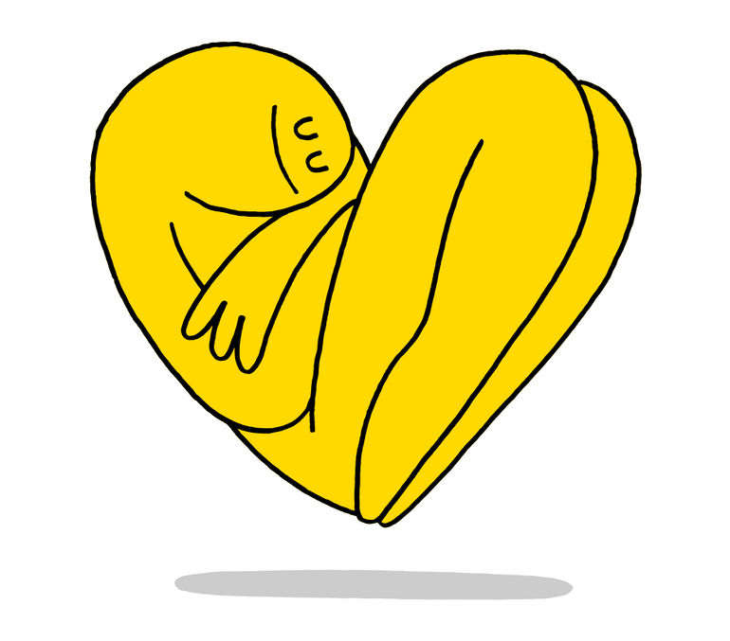


Slide 48
Rejection
Rejection affects our mood, our energy, and sometimes our self-esteem.
Examples:
School
After-school activities
Clubs
Notes:
48

Slide 49
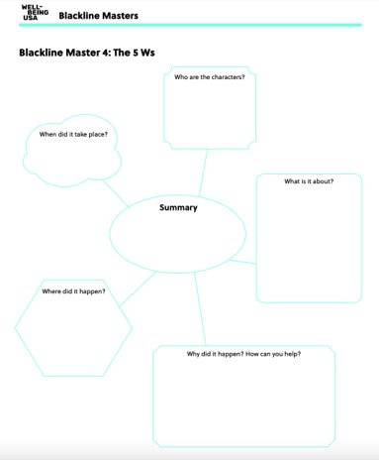
Role Playing
Get Creative
With your group:
  Create a role-play focusing on rejection or the act of being rejected.
  Use the sheet to plan the parts of your script. Think of someone being rejected by their friend or a group of their peers.
Feelings can be shown through words, facial expressions and body language.
Notes:
Teacher Note: A printable version of this sheet can be found in the lesson package
49

Slide 50

Responding and Giving Feedback
  How did each character feel and why?
  How can you reconstruct the scene so that it reflects acceptance and inclusion rather than rejection?
  What could have been done differently to provide a more positive outcome?
  Describe what happened in your scene. Include the point of view of the character, whether it was the main character or a bystander.
  How did you feel about the outcome? How could it be handled differently to ensure that people's feelings were not hurt?
Reflect on your own script:
Notes:
50

Slide 51
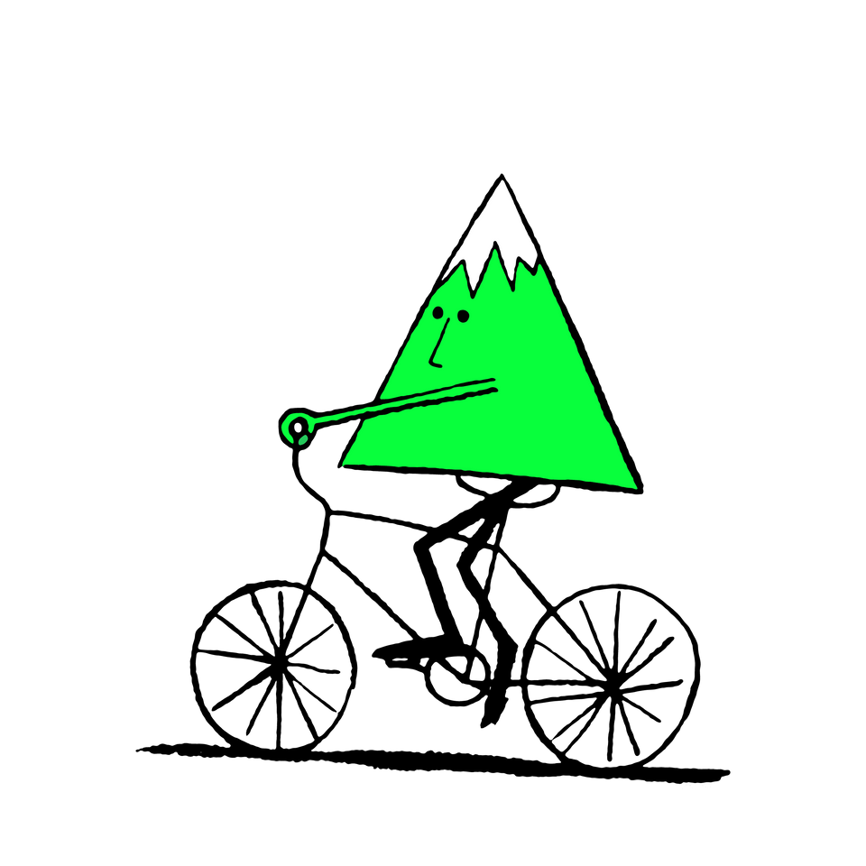
What Can We Learn From Rejection?
Think-Pair-Share
Why should we confront rather than avoid situations
that might result in rejection?
Notes:
51

Slide 52
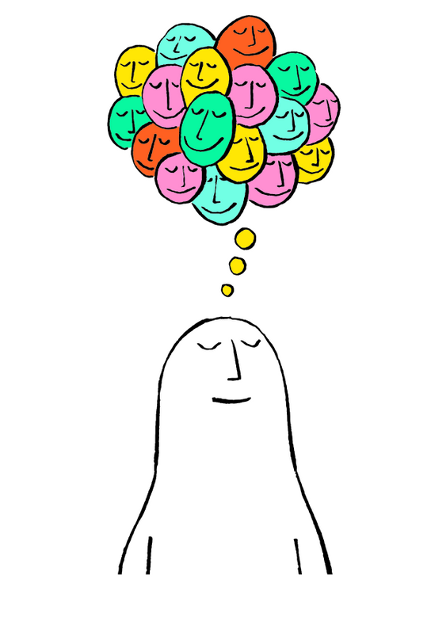

5

Slide 53
Changing Relationships
Relationships change over the course of your life.
Think-Pair-Share
How has your relationship changed with:
  your parents
  your siblings
  your close friends
Notes:
53

Slide 54
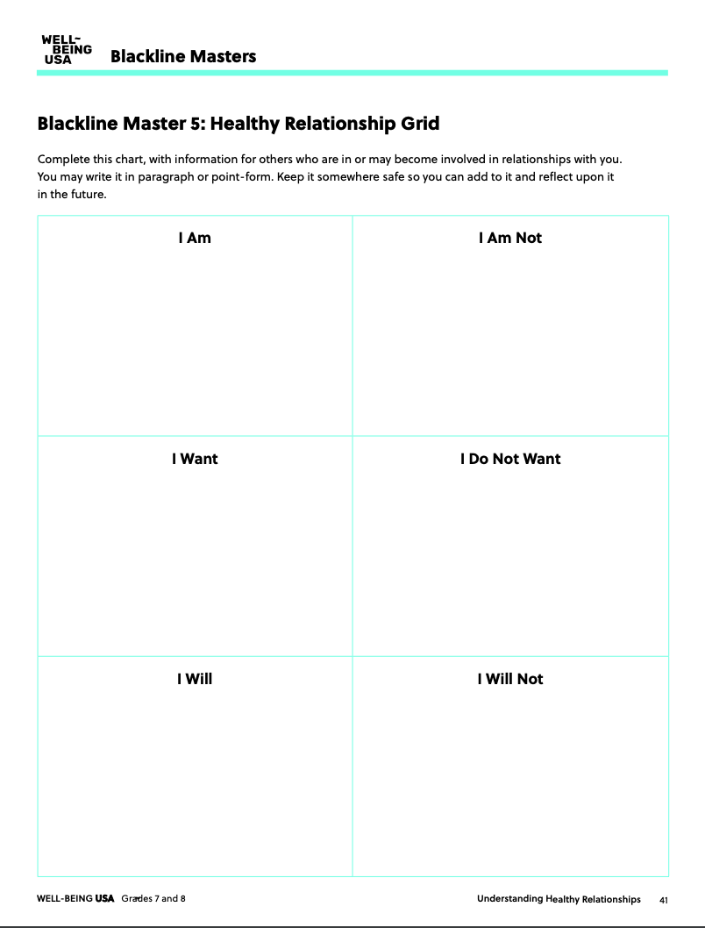
Healthy Relationships
Who are you as an individual?
What role do you want to play in the relationships you have in your life?
Fill in the chart:
  use words and phrases that apply to you.
  Elaborate in paragraph form with details to explain your thoughts clearly
Notes:
Teacher Note: A printable version of this sheet can be found in the lesson package
54

Slide 55
Let's Review
  you have different needs and wants in relationships
  you have core values
  we have to set clear boundary goals within relationships
  there are strategies to deal with rejection
Think about it...
Are you living up to your own expectations of yourself that you documented on the chart?
Notes:
55

Slide 56
Engaging in More Meaningful and Authentic Relationships
Talk Time
With your group, discuss:
  How have your partners, family and friends reacted to your learning?
  Do you think the exercises and assignments will influence the way you behave in your relationships?
  How can work that involves self-assessment strengthen relationships?
Notes:
Teacher Note: A printable version of this sheet can be found in the lesson package
56

Slide 57
Public Service Announcement
Get Creative
With your group:
  Create a PSA focusing on healthy relationships.
  Include elements from the lessons to create projects that are authentic and speak to your peers and the community.
Notes:
Teacher Note: A printable version of this sheet can be found in the lesson package
57

Slide 58

Action Plan
  Why is it important to be aware of how to establish and maintain a healthy relationship?
  Why is it important to understand the signs of an unhealthy relationship?
  How can you share this knowledge with other people in the community?
  Why is awareness important?
Notes:
58

Slide 59
Action Plan Continued
  How can we help people in our family and community raise awareness about healthy relationships?
  What actions can we take to raise awareness in our:
Family
School
Community
Notes:
59

Slide 60
Take Action
Let's choose an action to raise awareness!
  What will be our cause?
  Who will be our audience?
  How will we be organized – as a class, small groups, as a school?
  What materials to do we need?
  Do we need outside help – volunteers, speakers?
Notes:
60

Slide 61

Celebrate
It's time to share what we have learned and the actions we have taken!
How can we continue to raise awareness about the importance of healthy relationships for everyone?
Notes:
61

Slide 62

Thank you!

