Slide 1
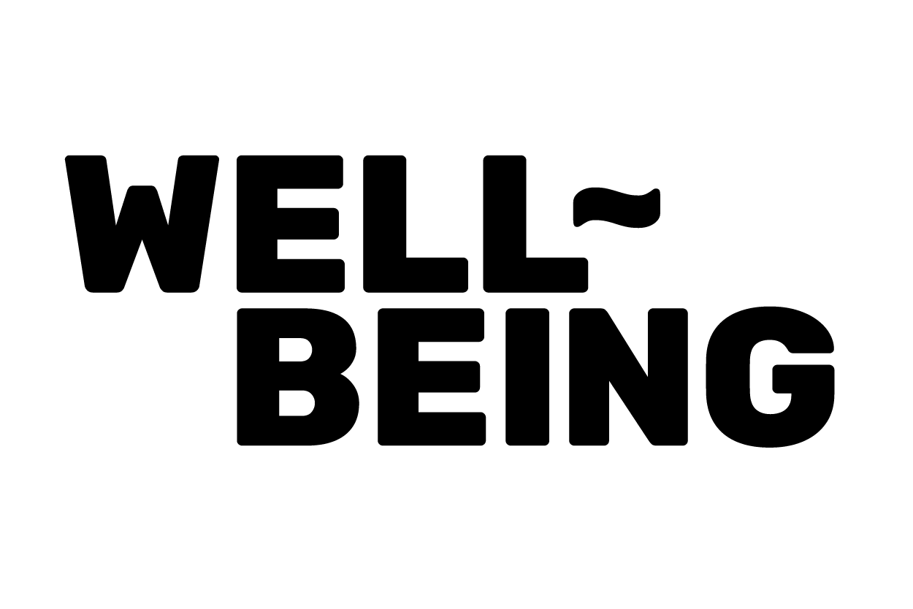
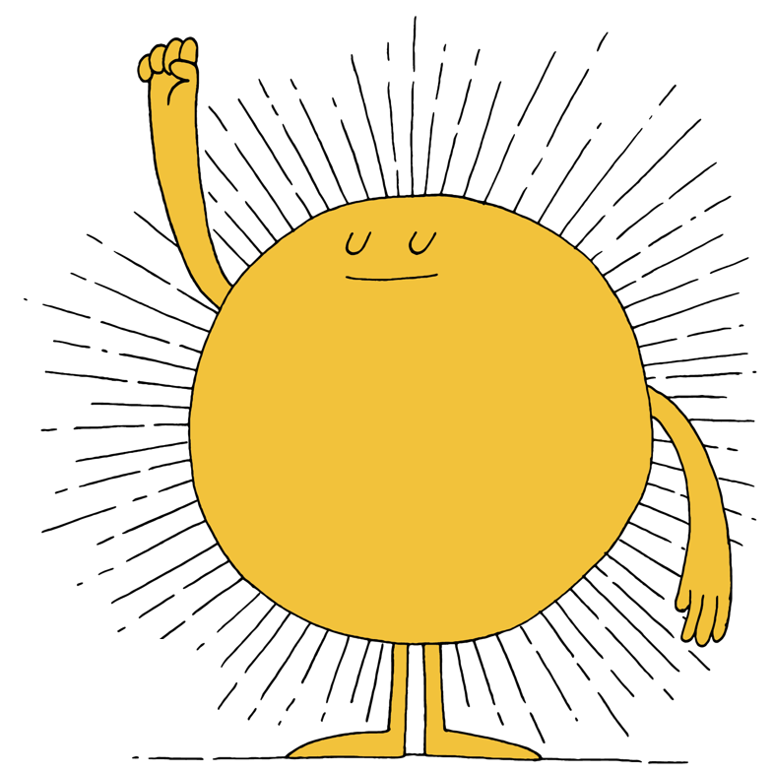
Unit Milestone Newsletter Templates
These end-of-unit milestone newsletters are designed to update families and caregivers on the new well-being skills their children have learned in class.
Use the following implementation steps:
Instructions:
You can either email the unit newsletter update -or- print the unit newsletter (keep in mind there are 2 per page, so you need to print half of your class student count).
If printing, cut the newsletters in half along the dotted line.
Send home with your students, encouraging them to share about each lesson from the unit with the members of their household.
Be sure to share the Home Connection Activity Cards with your students’ families and caregivers. Suggested activity cards are included in each newsletter.
When schools and homes connect,
we all win!

Slide 2

Unit 1:
Well-Being and Mindfulness
Dear Parents and Guardians,
Great news! Our class completed lessons 1-4 of the Well-Being Program! This unit started with an introduction to well-being and mindfulness. Here's a summary of each lesson.
Lesson 1: Let’s Get Started
We learned about well-being and discussed what it looks like, sounds like, and feels like to each of us.
Lesson 2: The Road to Mindfulness
We learned about mindfulness and how we can practice mindfulness in our daily lives. We even did a Tasting with Mindfulness lab!
Lesson 3: The Road to Setting Intentions
We learned the difference between setting goals and setting intentions.
Lesson 4: Acting with Intention
We discussed what we’re doing when we are our best selves and how those moments make us feel, then turned those ideas into intentions!
Home Connection
Connect your child's classroom learning to home. Try these related Home Activity Cards with your household: 1. Self-Care 101, 2. Relationships with Mindfulness, 3. Boost your Mood.
Unit 1:
Well-Being and Mindfulness
Dear Parents and Guardians,
Great news! Our class completed lessons 1-4 of the Well-Being Program! This unit started with an introduction to well-being and mindfulness. Here's a summary of each lesson.
Lesson 1: Let’s Get Started
We learned about well-being and discussed what well-being looks like, sounds like, and feels like to each of us.
Lesson 2: The Road to Mindfulness
We learned about mindfulness and how we can practice mindfulness in our daily lives. We even did a Tasting with Mindfulness lab!
Lesson 3: The Road to Setting Intentions
We learned the difference between setting goals and setting intentions.
Lesson 4: Acting with Intention
We discussed what we’re doing when we are our best selves and how those moments make us feel, then turned those ideas into intentions!
Home Connection
Connect your child's classroom learning to home. Try these related Home Activity Cards with your household: 1. Self-Care 101, 2. Relationships with Mindfulness, 3. Boost your Mood.

Slide 3
Unit 2:
Learning about Gratitude
Dear Parents and Guardians,
We did it! Our class has completed lessons 5-7 of the Well-Being Program! Below is a summary of each lesson:
Lesson 5: The Road to Gratitude
We learned about what gratitude is and how it affects our mental and physical well-being.
Lesson 6: Expressing Gratitude
We brainstormed who we are grateful for, how we can express gratitude, and then created our expressions of gratitude.
Lesson 7: Reflecting on and Celebrating Gratitude
We reflected on our full experience with gratitude and how it made us and others feel.
Home Connection
Connect your child's classroom learning to home. Try these related Home Activity Cards with your household: 1. Grow your Gratitude, 2. Healthy Communication
Unit 2:
Learning about Gratitude
Dear Parents and Guardians,
We did it! Our class has completed lessons 5-7 of the Well-Being Program! Below is a summary of each lesson:
Lesson 5: The Road to Gratitude
We learned about what gratitude is and how it affects our mental and physical well-being.
Lesson 6: Expressing Gratitude
We brainstormed who we are grateful for, how we can express gratitude, and then created our expressions of gratitude.
Lesson 7: Reflecting on and Celebrating Gratitude
We reflected on our full experience with gratitude and how it made us and others feel.
Home Connection
Connect your child's classroom learning to home. Try these related Home Activity Cards with your household: 1. Grow your Gratitude, 2. Healthy Communication

Slide 4
Unit 3:
Learning about Empathy and Compassion
Dear Parents and Guardians,
We’ve grown our well-being again! Our class has completed lessons 8-9 of the Well-Being Program! Below is a summary of each lesson:
Lesson 8: The Road to Empathy
We learned about how empathy means understanding and sharing the feelings of another person and we identified different types of feelings.
Lesson 9: The Road to Compassion
We learned how compassion is like empathy in action and we discussed how we can show compassion to others.
Home Connection
Connect your child's classroom learning to home. Try these related Home Activity Cards with your household: 1. Name it to Tame it, 2. Empathy and Compassion, 3. Is your Glass Half Full?
Unit 3:
Learning about Empathy and Compassion
Dear Parents and Guardians,
We’ve grown our well-being again! Our class has completed lessons 8-9 of the Well-Being Program! Below is a summary of each lesson:
Lesson 8: The Road to Empathy
We learned about how empathy means understanding and sharing the feelings of another person and we identified different types of feelings.
Lesson 9: The Road to Compassion
We learned how compassion is like empathy in action and we discussed how we can show compassion to others.
Home Connection
Connect your child's classroom learning to home. Try these related Home Activity Cards with your household: 1. Name it to Tame it, 2. Empathy and Compassion, 3. Is your Glass Half Full?

Slide 5
Unit 4:
Learning about Altruism
Dear Parents and Guardians,
We’re on a well-being roll! Our class has completed lessons 10-13 of the Well-Being Program! Below is a summary of each lesson:
Lesson 10: The Road to Altruism
We learned about what altruism is and we brainstormed altruistic actions we have done in the past.
Lesson 11: Acting with Altruism
We brainstormed people that are in need of our kindness and discussed acts of altruism we could do for them.
Lesson12: Altruism in Action
We took our discussion from lesson 11 and put our altruistic ideas into practice!
Lesson 13: Reflecting on and Celebrating Altruism
We reflected on our entire experience with altruism and how it felt to express altruism as a class.
Home Connection
Connect your child's classroom learning to home. Try this related Home Activity Card with your household: 1. When you give, You Get Well
Unit 4:
Learning about Altruism
Dear Parents and Guardians,
We’re on a well-being roll! Our class has completed lessons 10-13 of the Well-Being Program! Below is a summary of each lesson:
Lesson 10: The Road to Altruism
We learned about what altruism is and we brainstormed altruistic actions we have done in the past.
Lesson 11: Acting with Altruism
We brainstormed people that are in need of our kindness and discussed acts of altruism we could do for them.
Lesson12: Altruism in Action
We took our discussion from lesson 11 and put our altruistic ideas into practice!
Lesson 13: Reflecting on and Celebrating Altruism
We reflected on our entire experience with altruism and how it felt to express altruism as a class.
Home Connection
Connect your child's classroom learning to home. Try this related Home Activity Card with your household: 1. When you give, You Get Well

Slide 6
Unit 5:
Learning about Resilience
Dear Parents and Guardians,
Mission accomplished! Our class has completed lessons 14-15, the final lessons of the Well-Being Program! Below is a summary of each lesson:
Lesson 14: The Road to Resilience
We learned about resilience and how we can endure in the face of challenges and adversity.
Lesson 15: Reflecting on and Celebrating Well-Being
We reflected on our journey through the Well-Being Program and discussed how we can continue our well-being practices going forward.
Home Connection
Connect your child's classroom learning to home. Try these related Home Activity Cards with your household: 1. You Got This, 2. Get the Ball Rolling
Unit 5:
Learning about Resilience
Dear Parents and Guardians,
Mission accomplished! Our class has completed lessons 14-15, the final lessons of the Well-Being Program! Below is a summary of each lesson:
Lesson 14: The Road to Resilience
We learned about resilience and how we can endure in the face of challenges and adversity.
Lesson 15: Reflecting on and Celebrating Well-Being
We reflected on our journey through the Well-Being Program and discussed how we can continue our well-being practices going forward.
Home Connection
Connect your child's classroom learning to home. Try these related Home Activity Cards with your household: 1. You Got This, 2. Get the Ball Rolling

