Slide 1
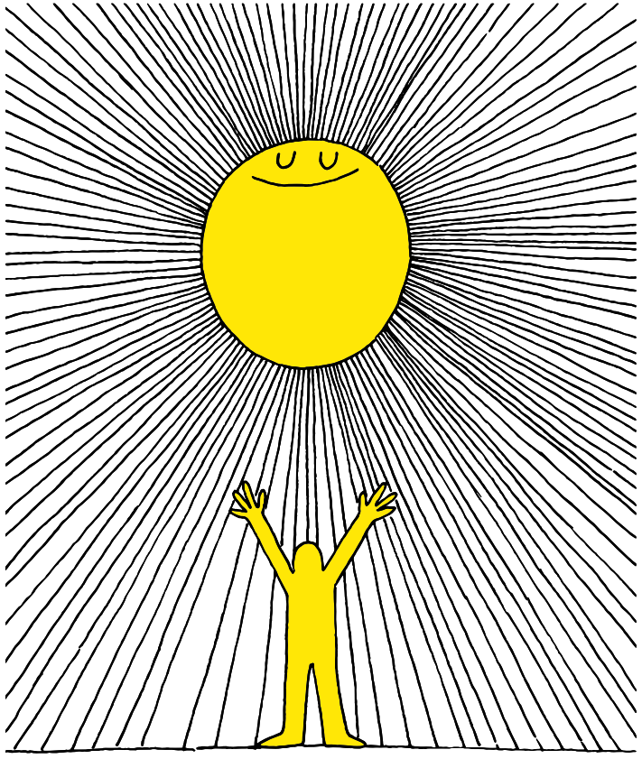
1q

Slide 2
Lesson PowerPoint Table of Contents
Lesson 5: The Road to Gratitude
Lesson 6: Expressing Gratitude
Slides 3-14
What is gratitude?
Noticing gratitude
Gratitude and well-being
Slides 15-20
Gratitude review
Who are we grateful for?
How can we express gratitude?
Lesson 7:
Reflecting and Celebrating Gratitude
Slides 21-24
A walk down memory lane
Gratitude reflection and continuing gratitude

Slide 3
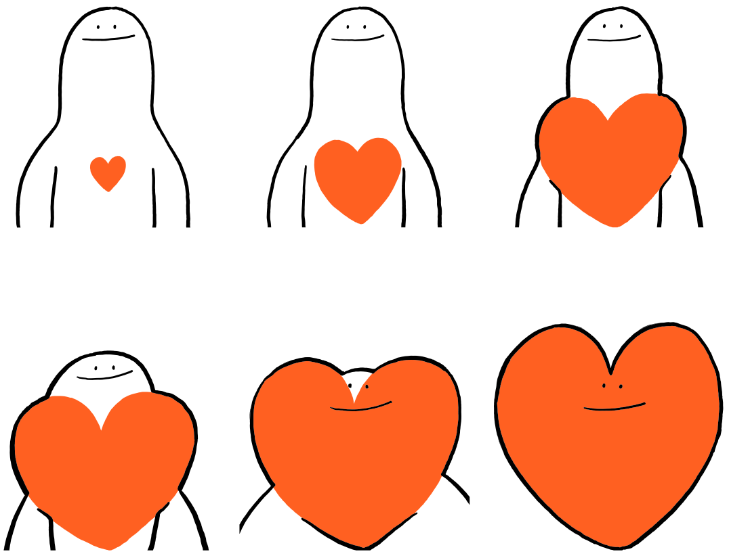

Slide 4
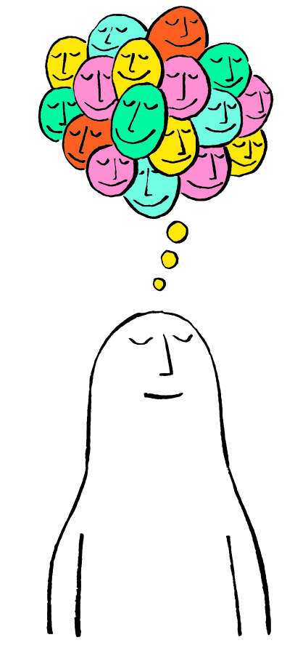
First, find a comfortable seat.
Balloon Breathing
Then, close your eyes or pick a spot on the floor to focus on.
Next, notice what you hear around you.
After you settle into your comfy spot, focus on breathing in through your nose, out through your mouth.
Finally, imagine your belly is a balloon. Fill up nice and round before you exhale. Do this for 2 minutes.

Slide 5
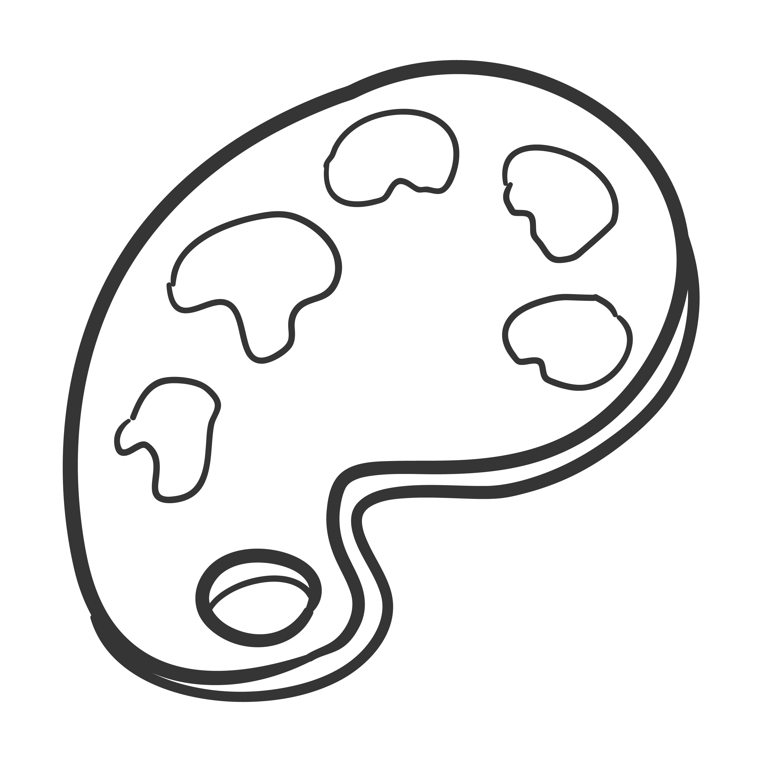
What are you Thankful For?
Independent Writing
Draw or write about someone or something you are thankful for...
Notes:
Teacher note: Let your students be creative here! They can draw, paint, build with Play-doh, or write- whatever you would like to offer them to be able to do!

Slide 6
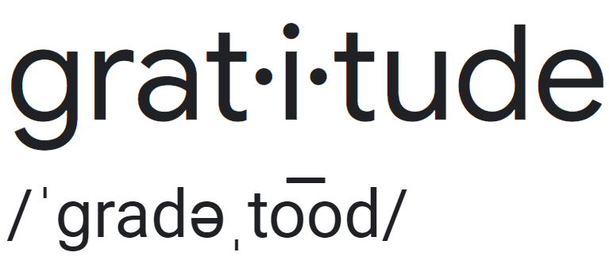
What is “Resilience”?
noun
Definition: The quality of being thankful; wanting to show appreciation and to return kindness.
Think-Pair-Share
What does this definition mean to you?

Slide 7
What is “Gratitude”?
Think-Pair-Share
How do you show gratitude?
Where have you heard about gratitude?
How do you think gratitude is related to well-being?

Slide 8
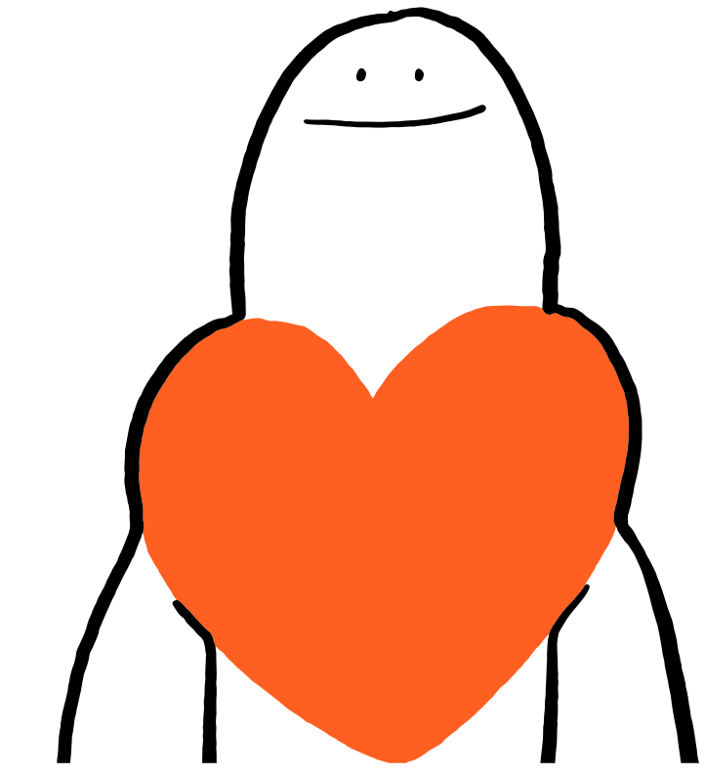
Thoughts About Gratitude
Share Out!
What are your thoughts on gratitude?
Who do you show gratitude to?
When do you show gratitude?
How does it feel to be grateful?

Slide 9
My Gratitude Jar by Kristin Wiens
As you watch, be a gratitude detective and notice examples of gratitude.

Slide 10
My Gratitude Jar by Kristin Wiens
Reading Response
Did you see any examples of gratitude in the story?

Slide 11
The Science of Gratitude
Scientists have proven that gratitude can help us…
• Feel happier
• Sleep better
• Feel more connected to people and our community
• Feel better when we’re sad
• Be kinder and help others
• Have healthier bodies (immune system)

Slide 12
Gratitude Detectives
Think-Pair-Share
What does a detective do?
What do you think a gratitude detective would do?

Slide 13
Our Gratitude Jar
As you see or feel gratitude over the next few days, write those moments down in your journal or to put in our Gratitude Jar so we can share the goodness of gratitude with each other!

Slide 14
Ask your class these questions in trivia game style, or create a gratitude Kahoot
Gratitude can make you feel happier. True* or False?
Gratitude takes a lot of time to practice. True or False*?
Gratitude can help you sleep better. True* or False?
Gratitude doesn’t help you feel better when you’re sick. True or False*?
Gratitude can help you feel closer to people in your life. True* or False?
Gratitude can stop you from getting sick as often. True* or False?
Gratitude can help when you’re feeling sad. True* or False?
Gratitude can help people become more helpful to others. True* or False?
Gratitude can help you feel more connected to your community. True* or False?
Expressing thanks to others can boost your happiness. True* or False?
Gratitude can change your brain. True* or False?

Slide 15
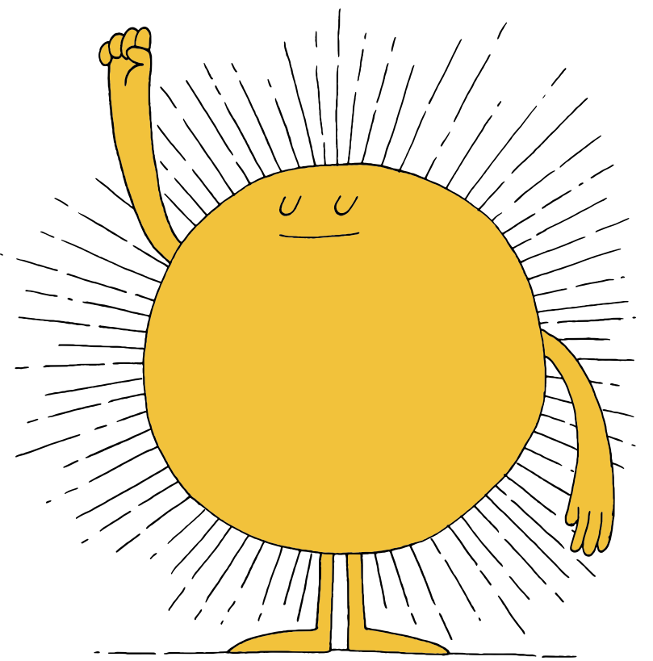

Slide 16
First, find a comfortable seat.
Balloon Breathing
Then, close your eyes or pick a spot on the floor to focus on.
Next, notice what you hear around you.
After you settle into your comfy spot, focus on breathing in through your nose, out through your mouth.
Finally, imagine your belly is a balloon. Fill up nice and round before you exhale. Do this for 2 minutes.

Slide 17
Gratitude Review
noun
Definition: The quality of being thankful; wanting to show appreciation and to return kindness.
Think-Pair-Share
What have you found in your gratitude detective work?
Do you think gratitude can be difficult to find sometimes?
Why or why not?

Slide 18
Who are we Grateful For?
Brainstorm:
Who in our school and community are we grateful for?
Class Choice:

Slide 19
How can we Express Gratitude?
Brainstorm:
How could we express how gratitude to our person/group?
Class Choice:

Slide 20
Take Action!
Create your expressions of gratitude!

Slide 22
First, find a comfortable seat.
Balloon Breathing
Then, close your eyes or pick a spot on the floor to focus on.
Next, notice what you hear around you.
After you settle into your comfy spot, focus on breathing in through your nose, out through your mouth.
Finally, imagine your belly is a balloon. Fill up nice and round before you exhale. Do this for 2 minutes.

Slide 23
A Walk Down Memory Lane
Think-Pair-Share
Who did we choose and why were we thankful for them?
How did we express our gratitude?
How did you feel and how do you think we made the other person/people feel?

Slide 24
Gratitude Reflection
Brainstorm:
Now that we have worked together on gratitude, how could you continue to show gratitude to people we’re thankful for?
Think-Pair-Share
What is your favourite way to express gratitude?

Slide 25
