Slide 2
Lesson PowerPoint Table of Contents
Lesson 8: The Road to Empathy
Lesson 9: The Road to Compassion
Slides 3-17
What is empathy?
Empathy scenarios
Empathy reflection
Slides 18-33
What is compassion?
Compassion scenarios
Compassion reflection

Slide 3
Review
Think-Pair-Share
What is well-being?
What is mindfulness?
How does mindfulness support our well-being?
What is the difference between setting a goal and setting an intention?

Slide 5
First, find a comfortable seat.
Balloon Breathing
Then, close your eyes or pick a spot on the floor to focus on.
Next, notice what you hear around you.
After you settle into your comfy spot, focus on breathing in through your nose, out through your mouth.
Finally, imagine your belly is a balloon. Fill up nice and round before you exhale. Do this for 2 minutes.

Slide 6
Movie Scenario #1
As you watch, think about how the characters in the story feel.

Slide 7
Movie Scenario
Poppy felt ______, so she lost her color
All the other trolls lost their color, too.
Why do you think made the other trolls lose their color, too?

Slide 8
What is “Empathy”?
noun
Definition: Understanding and sharing the feelings of another person.
Think-Pair-Share
What does empathy look like in your life?
How can empathy help us form healthy relationships?

Slide 9
Feelings Brainstorm
Bad Feelings
Middle Feelings
Good Feelings

Slide 10
Empathy Scenarios
Scenario:
A classmate found out she was not included in an invitation for the birthday party of another classmate.
Think-Pair-Share
What might the student be thinking?
What might the student be feeling?
3. Have you ever felt that way?

Slide 11
Empathy Scenarios
Scenario:
A classmate has worked on a science project about a topic they’re passionate about. They have put weeks of effort into the project and get selected to present their project in front of the whole school.
Think-Pair-Share
What might the student be thinking?
What might the student be feeling?
3. Have you ever felt that way?

Slide 12
Empathy Scenarios
Scenario:
One of your classmates has not studied for a test that you have tomorrow.
Think-Pair-Share
What might the student be thinking?
What might the student be feeling?
3. Have you ever felt that way?

Slide 13
Empathy Scenarios
Scenario:
A group of students at your school have started a fundraising campaign to give clean water access to a community in need. They received twice the amount of donations they expected, doubling their fundraising goal.
Think-Pair-Share
What might the student be thinking?
What might the student be feeling?
3. Have you ever felt that way?

Slide 14
Share Out!
Which scenario reminded you the most of something in your own life?
When we notice someone feeling upset, what can we show them empathy?
How does empathy help our relationships with others?

Slide 15
Movie Scenario #2
As you watch, look for how characters show empathy.

Slide 16
Movie Scenario #2
Happiness means “the experience of joy, contentment, or positive well-being.” Do you think sadness can happen while maintaining positive well-being?
Can you explain the role of sadness and how it is important?
How did Riley’s parents show empathy to her?

Slide 17
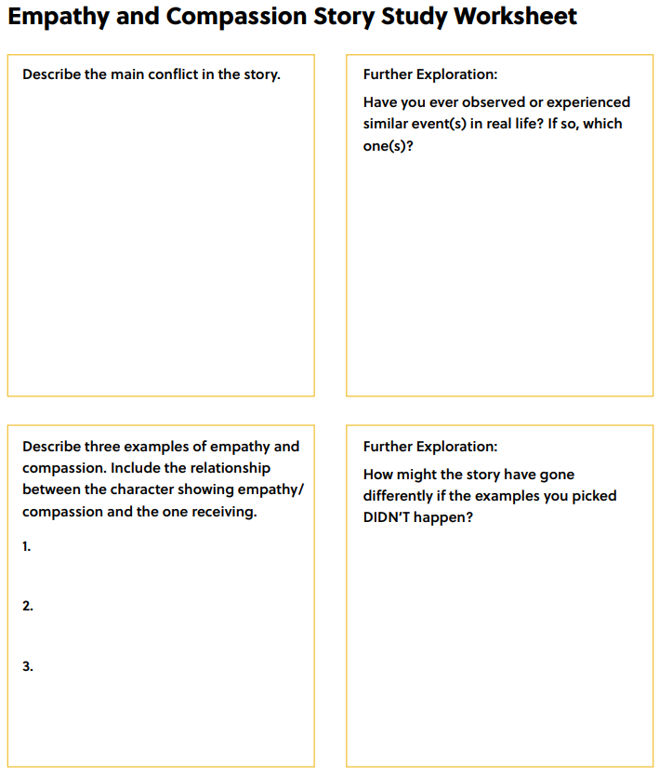
Story Study (optional)
Notes:
Teacher Note: A printable version of this sheet can be found in the lesson package

Slide 19
Empathy Review
noun
Definition: Understanding and sharing the feelings of another person.
Think-Pair-Share
What is empathy to you in your own words?
Why does empathy help our relationships?

Slide 20
First, find a comfortable seat.
Balloon Breathing
Then, close your eyes or pick a spot on the floor to focus on.
Next, notice what you hear around you.
After you settle into your comfy spot, focus on breathing in through your nose, out through your mouth.
Finally, imagine your belly is a balloon. Fill up nice and round before you exhale. Do this for 2 minutes.

Slide 21
Quote Reflection
“Be kind, for everyone you meet is fighting a hard battle.”
- Plato
Independent Writing
When you hear this quote, what does it mean to you?
What do you think it is about?

Slide 22
Quote Reflection Share Out
“Be kind, for everyone you meet is fighting a hard battle.”
- Plato
When you hear this quote, what does it mean to you?
What do you think it is about?

Slide 23
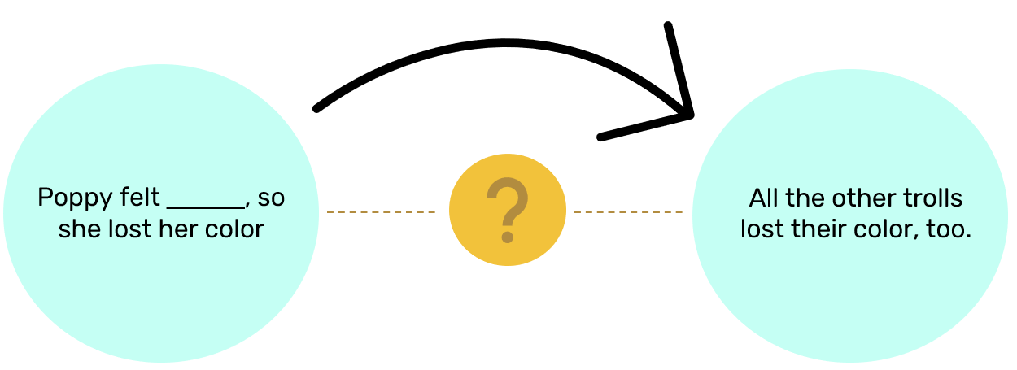
What is “Compassion”?
noun
Definition: Concern for the well-being of someone who is suffering and a desire to ease that person’s suffering.
Think back to the Trolls movie scenario…
First,
Then,
The other trolls showed empathy by losing their color
Branch showed compassion by helping Poppy feel better.

Slide 24
What is “Compassion”?
Popcorn Thoughts
What does compassion look like in your life?
How might compassion help your friendships?
How do you see compassion in your community?
How is compassion the same or different from empathy?

Slide 25
Empathy vs Compassion
Compassion is like empathy in action.
First, we show empathy by understanding how a person feels.
Then, we can show compassion by doing something to try to make them feel better.

Slide 26
Compassion Scenarios
Scenario:
There is a new student joining the class.
Think-Pair-Share
What might the student be thinking and feeling?
Have you ever felt that way?
3. What actions could you take to show compassion?

Slide 27
Compassion Scenarios
Scenario:
A student is being teased.
Think-Pair-Share
What might the student be thinking and feeling?
Have you ever felt that way?
3. What actions could you take to show compassion?

Slide 28
Compassion Scenarios
Scenario:
A student lost their favorite toy in the schoolyard.
Think-Pair-Share
What might the student be thinking and feeling?
Have you ever felt that way?
3. What actions could you take to show compassion?

Slide 29
Share Out!
How do empathy and compassion help our relationships with others?

Slide 30
Movie Scenario
As you watch, look for how characters show empathy.

Slide 31
Movie Scenario
How does Cindy Loo have compassion for someone like the Grinch?
How does the quote “Be kind, for everyone you meet is fighting a hard battle” relate to what Mr. Grinch is experiencing?
Why is compassion a strong trait and attribute of character?

Slide 32
Empathy and Compassion Key Message
Empathy and compassion are important for our
well-being.
Empathy and compassion are central
to having positive relationships with others
because it helps us show others that we care.

Slide 33
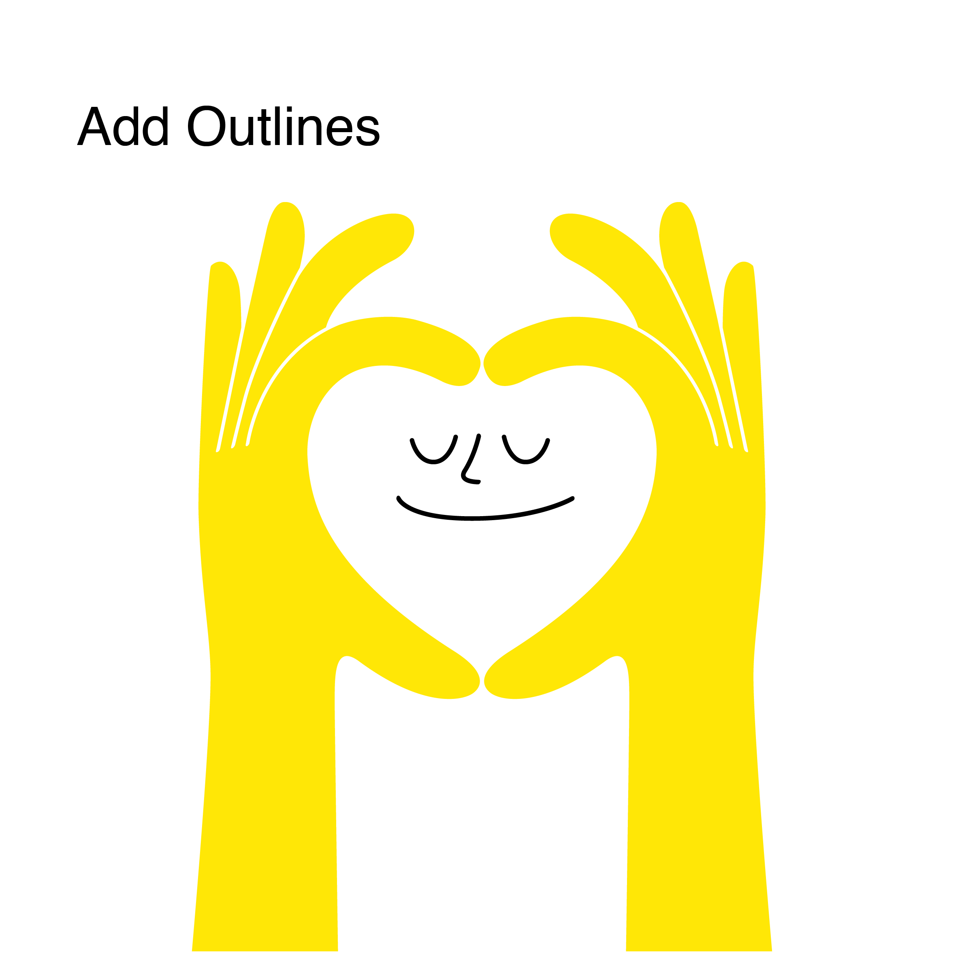
Daily Action
Independent Writing
Draw or write to show how you can add more empathy and compassion into your life at school, in your community, and at home.

