Slide 1
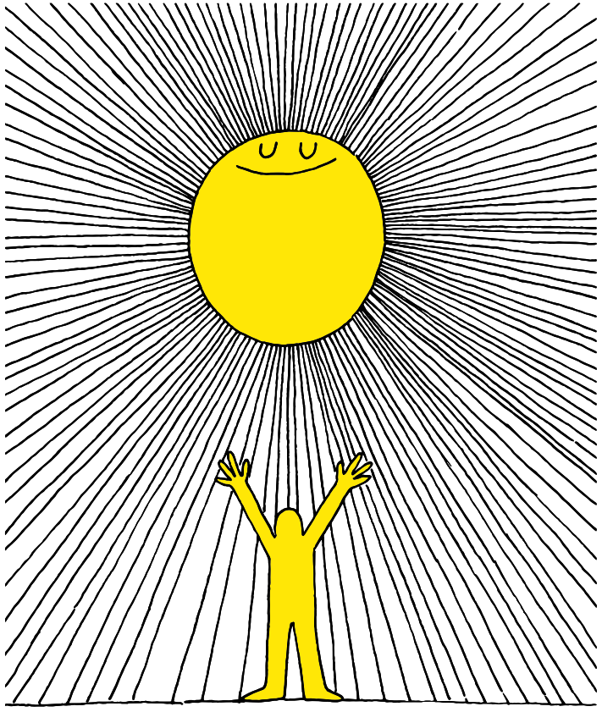

Slide 2
Lesson PowerPoint Table of Contents
Lesson 5: The Road to Gratitude
Lesson 6: Expressing Gratitude
Slides 3-20
What is gratitude?
Noticing gratitude
Gratitude and well-being
Slides 21-27
Gratitude review
Who are we grateful for?
How can we express gratitude?
Lesson 7:
Reflecting and Celebrating Gratitude
Slides 28-33
A walk down memory lane
Gratitude reflection and continuing gratitude

Slide 3
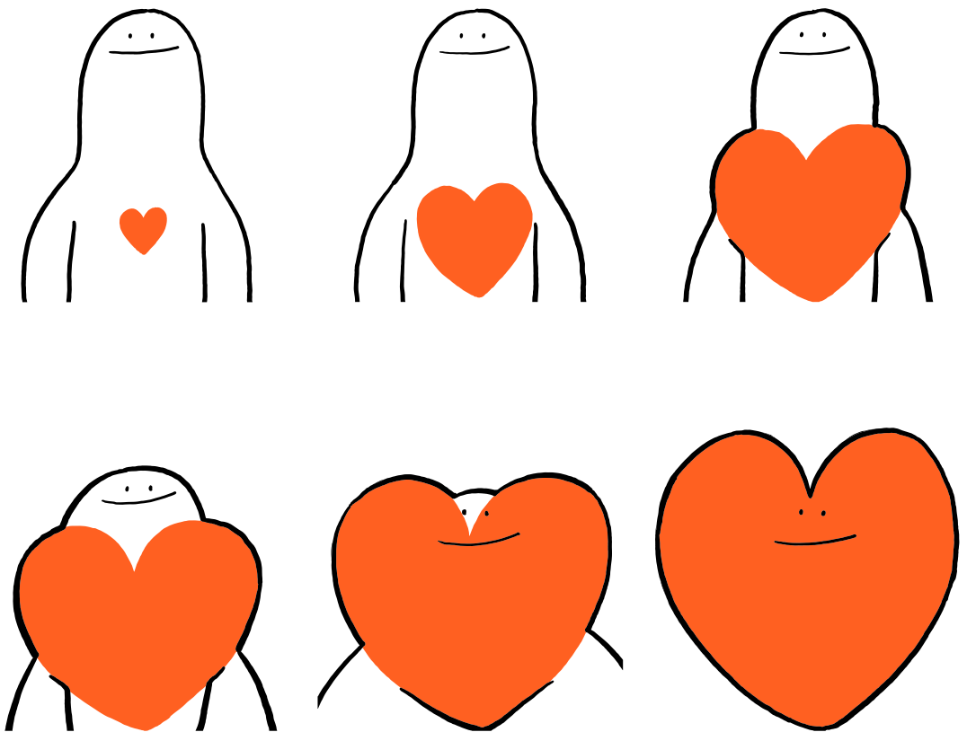

Slide 4
Review
Think-Pair-Share
What is well-being?
What is mindfulness?
What is the difference between setting a goal and setting an intention?

Slide 5
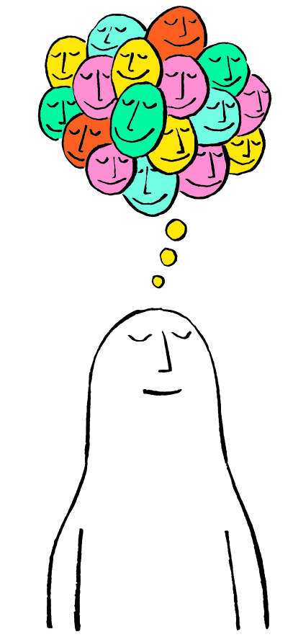
First, find a comfortable seat.
Balloon Breathing
Then, close your eyes or pick a spot on the floor to focus on.
Next, notice what you hear around you.
After you settle into your comfy spot, focus on breathing in through your nose, out through your mouth.
Finally, imagine your belly is a balloon. Fill up nice and round before you exhale. Do this for 2 minutes.

Slide 6
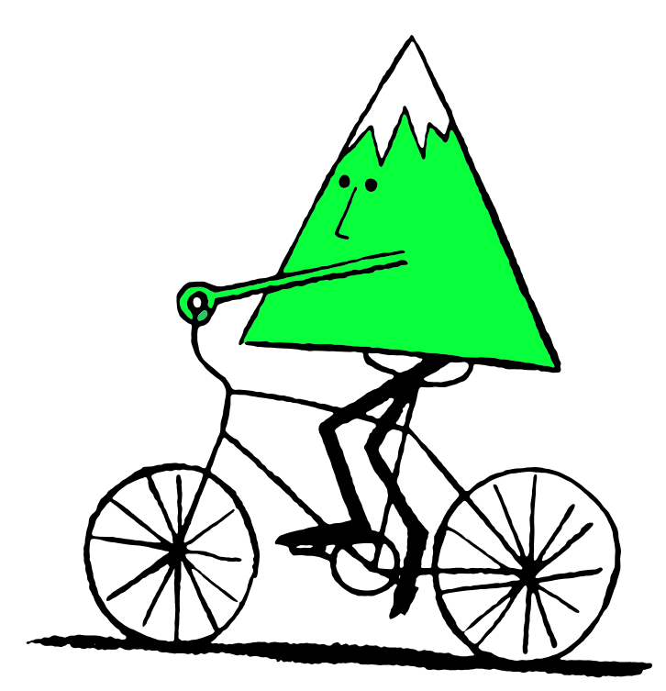
Set an Intention
Before we start today, take a quiet moment to set an intention.
Examples
I will be open to learning something new
I will active listen with curiosity
I will be mindful of my thoughts as I listen
I will be kind to myself today

Slide 7
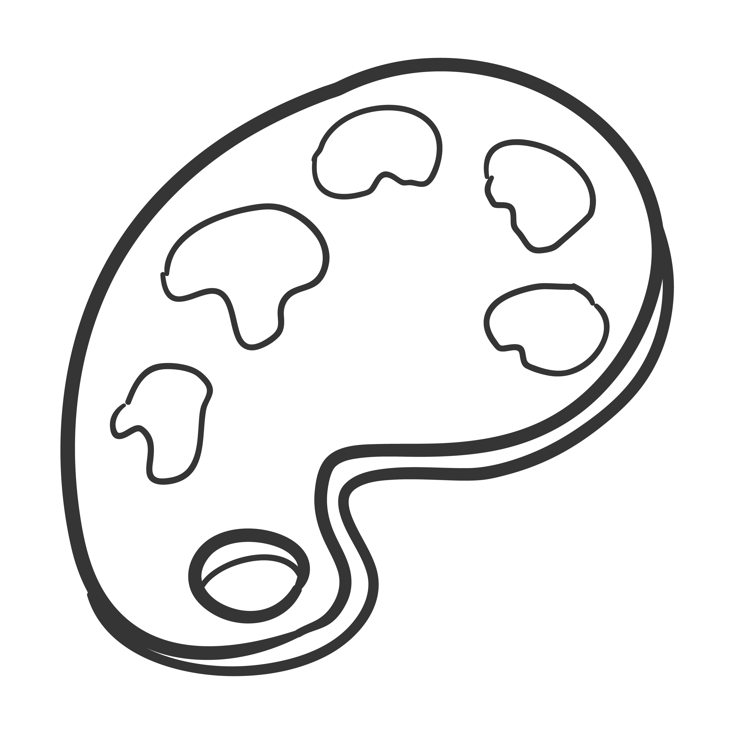
What are you Thankful For?
Independent Writing
Draw or write about someone or something you are thankful for
Notes:
Teacher note: Let your students be creative here! They can draw, paint, build with Play-doh, or write- whatever you would like to offer them to be able to do!

Slide 8
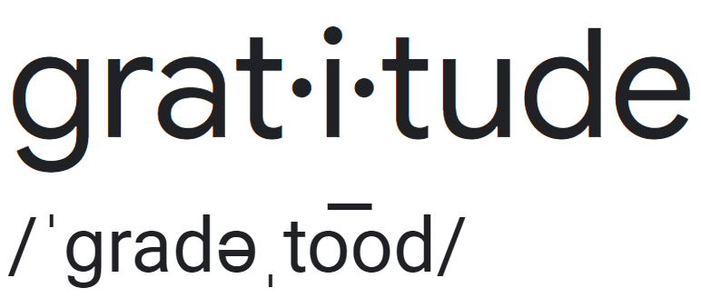
What is “Gratitude”?
noun
Definition: The quality of being thankful; wanting to show appreciation and to return kindness.
Think-Pair-Share
What does this definition mean to you?

Slide 9
What is “Gratitude”?
Think-Pair-Share
How do you show gratitude?
Where have you heard about gratitude?
How do you think gratitude is related to well-being?

Slide 10
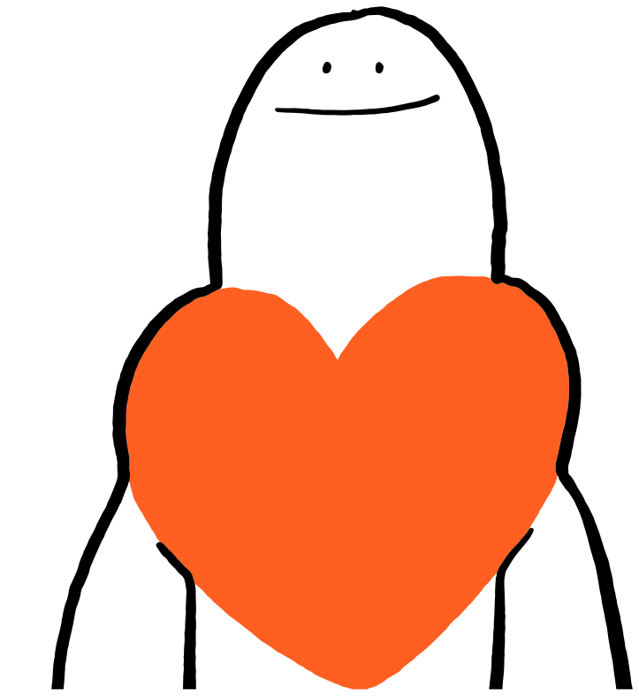
Thoughts About Gratitude
Share Out!
What are your thoughts on gratitude?
Who do you show gratitude to?
When do you show gratitude?
How does it feel to be grateful?
Notes:
Teacher note: Let your students be creative here! They can draw, paint, build with Play-doh, or write- whatever you would like to offer them to be able to do!

Slide 11
Movie Scenario #1
Popcorn Thoughts
What does Dorothy say to the Tinman, Lion, and Scarecrow?
How are Dorothy’s words an expression of gratitude?
Why is being thankful so powerful for the person who expresses it and for those who receive it?

Slide 12
Movie Scenario #2
Popcorn Thoughts
Why might we feel sad when we think about “things” not being permanent?
As the characters sang their song, what were they individually grateful for?
How does gratitude put us and our life in perspective that allows us to overcome change and challenges?

Slide 13
My Gratitude Jar by Kristin Wiens (3&4 grade option)
As you watch, be a gratitude detective and notice examples of gratitude.

Slide 14
My Gratitude Jar by Kristin Wiens (3&4 grade option)
Reading Response
Did you see any examples of gratitude in the story?

Slide 15
The Science of Gratitude (5+ grade option)
“The Amazing Effects of Gratitude,” TED-Ed
“The Science of Gratitude,” Tremendousness

Slide 16
The Science of Gratitude
Scientists have proven that gratitude can help us…
• Feel happier
• Sleep better
• Feel more connected to people and our community
• Feel better when we’re sad
• Be kinder and help others
• Have healthier bodies (immune system)

Slide 17
Gratitude Discussion
Think-Pair-Share
Where there any research findings that surprised you?
Do you see any links between your experience with gratitude and the science of gratitude?
Do you think it is worthwhile to practice gratitude? Why or why not?

Slide 18
Gratitude Journaling
As you see or feel gratitude over the next few days, write those moments down in your journal.
Think of yourself as a detective searching for people, things, and moments you’re grateful for!

Slide 19
Gratitude Reflection
Independent Writing
Write one or two things that were new for you today or if anything surprised you.
Write some ideas of where you can look for gratitude over the next few days.

Slide 20
Ask your class these questions in trivia game style, or create a gratitude Kahoot
Gratitude can make you feel happier. True* or False?
Gratitude takes a lot of time to practice. True or False*?
Gratitude can help you sleep better. True* or False?
Gratitude doesn’t help you feel better when you’re sick. True or False*?
Gratitude can help you feel closer to people in your life. True* or False?
Gratitude can stop you from getting sick as often. True* or False?
Gratitude can help when you’re feeling sad. True* or False?
Gratitude can help people become more helpful to others. True* or False?
Gratitude can help you feel more connected to your community. True* or False?
Expressing thanks to others can boost your happiness. True* or False?
Gratitude can change your brain. True* or False?

Slide 21
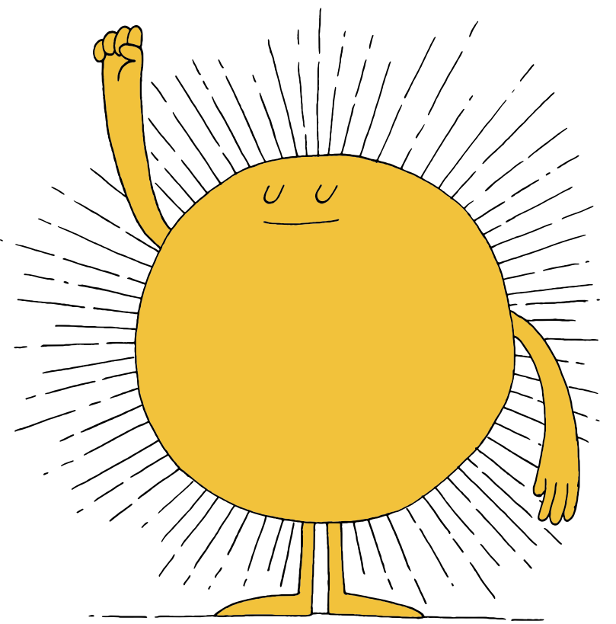

Slide 22
First, find a comfortable seat.
Balloon Breathing
Then, close your eyes or pick a spot on the floor to focus on.
Next, notice what you hear around you.
After you settle into your comfy spot, focus on breathing in through your nose, out through your mouth.
Finally, imagine your belly is a balloon. Fill up nice and round before you exhale. Do this for 2 minutes.

Slide 23
Gratitude Review
noun
Definition: The quality of being thankful; wanting to show appreciation and to return kindness.
Think-Pair-Share
What have you found in your gratitude detective work?
Do you think gratitude can be difficult to find sometimes? Why or why not?

Slide 24
An Experiment in Gratitude
*Caution: an inappropriate word is censored at 5:27 of this video*

Slide 25
Who Are We Grateful For?
Brainstorm:
Who in our school and community are we grateful for?
Class Choice:

Slide 26
How Can We Express Gratitude?
Brainstorm:
How could we express how gratitude to our person/group?
Class Choice:

Slide 27
Take Action!
Create your expressions of gratitude!

Slide 29
First, find a comfortable seat.
Balloon Breathing
Then, close your eyes or pick a spot on the floor to focus on.
Next, notice what you hear around you.
After you settle into your comfy spot, focus on breathing in through your nose, out through your mouth.
Finally, imagine your belly is a balloon. Fill up nice and round before you exhale. Do this for 2 minutes.

Slide 30
A Walk Down Memory Lane
Think-Pair-Share
Talk with your partner about our experience with gratitude.

Slide 31
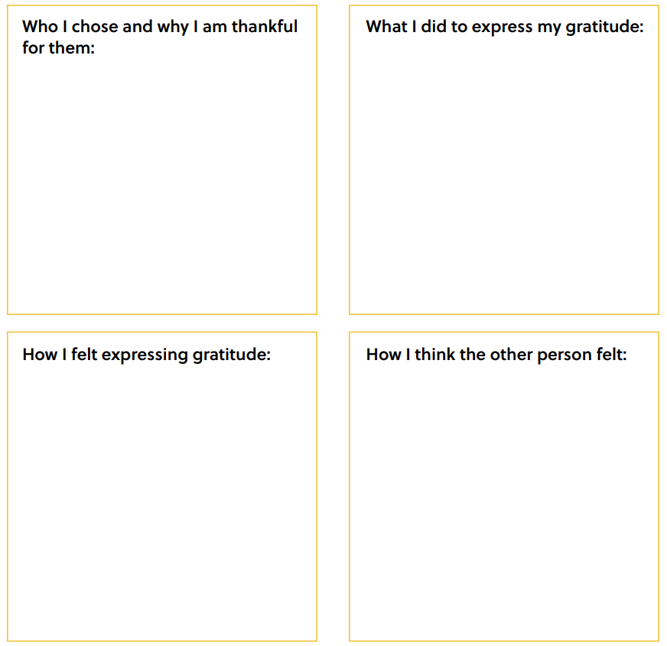
Gratitude Reflection
Notes:
Teacher Note: A printable version of this sheet can be found in the lesson package

Slide 32
Share out!
If you are comfortable, share your reflection about expressing gratitude

Slide 33
Final Reflection
Add to your reflection:
connections you see between your initial thoughts about gratitude and your classmates’ experiences expressing gratitude.
any next steps you could take to continue building gratitude in our classroom and school.

Slide 34
