Slide 2
Lesson PowerPoint Table of Contents
Lesson 10: The Road to Altruism
Lesson 11: Acting with Altruism
Slides 3-14
What is altruism?
Altruism and well-being
Acting with altruism
Slides 15-20
Altruism share out
Who needs altruism?
How can we show altruism?
Lesson 13: Reflecting and Celebrating Altruism
Lesson 12: Altruism in Action
Slides 21-24
Carrying out altruism
Slides 25-30
Altruism reflection
Spreading altruism

Slide 4
Review
Think-Pair-Share
What is well-being?
What is mindfulness?
What is empathy?
What is compassion? What is the difference between empathy and compassion?

Slide 5
First, find a comfortable seat.
Balloon Breathing
Then, close your eyes or pick a spot on the floor to focus on.
Next, notice what you hear around you.
After you settle into your comfy spot, focus on breathing in through your nose, out through your mouth.
Finally, imagine your belly is a balloon. Fill up nice and round before you exhale. Do this for 2 minutes.

Slide 6
An Altruistic Memory
Independent Writing
Think about a time where someone did something kind for you.
Once you’re settled in your memory, draw or write about it and how it made you feel.

Slide 7
What is “Altruism”?
noun
Definition: when we care about others and do kind acts that help them even though we don’t get anything in return by doing those acts.
Think-Pair-Share
Was the person from your drawing/writing showing altruism?
Why do we do kind things for others?

Slide 8
Partner Chat
Pick a Question
What does altruism look like to you?
How is altruism different from kindness? How are they the same?
How do you think altruism is related to well-being?
How might empathy and compassion be related to altruism?

Slide 9
Share Out!
What are your thoughts about helping others without receiving anything in return?
How do you think altruism might help us with our well-being?

Slide 10
Movie Scenario
Popcorn Thoughts
How does princess Tiana show altruism in this clip?
How does the practice of altruism spread happiness in oneself and others?
At the end of the clip, Princess Tiana makes an intention, can you identify what that intention is?

Slide 11
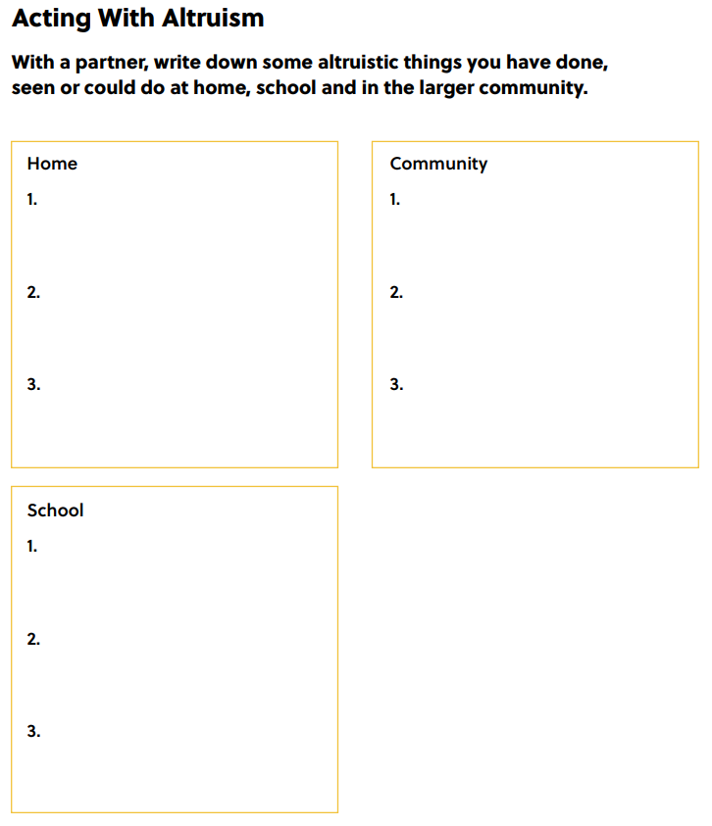
Partner Work option 1
Notes:
Teacher Note: A printable version of this sheet can be found in the lesson package

Slide 12
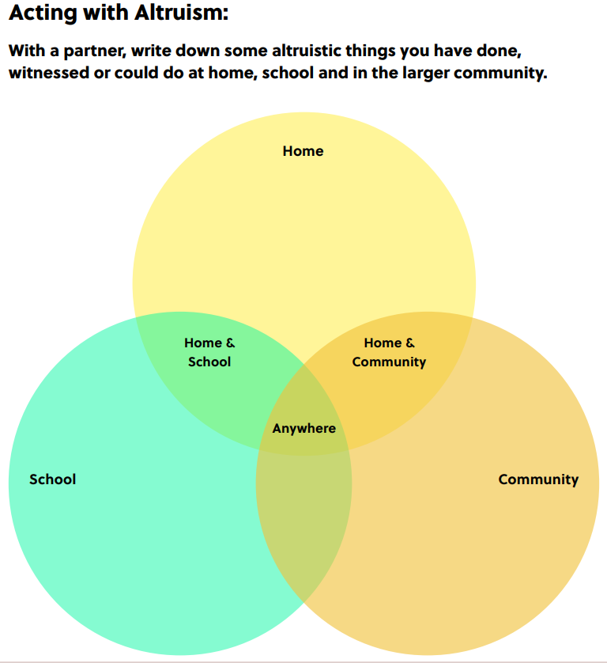
Partner Work option 2
Notes:
Teacher Note: A printable version of this sheet can be found in the lesson package

Slide 13
Share Out!
What ideas did you think up with your partner?
How do you think others feel when you act with altruism toward them?
How do you feel when you act with altruism?
How might altruism help our relationships with others?

Slide 14
Homework
Before the next time we continue our altruism lessons, try to either…
1. do an act of altruism
OR
2. look for someone else doing an act of altruism for you to share out!

Slide 16
First, find a comfortable seat.
Balloon Breathing
Then, close your eyes or pick a spot on the floor to focus on.
Next, notice what you hear around you.
After you settle into your comfy spot, focus on breathing in through your nose, out through your mouth.
Finally, imagine your belly is a balloon. Fill up nice and round before you exhale. Do this for 2 minutes.

Slide 17
Share Out!
Homework review:
Did you do or see an act of altruism?
Was it easy to do/find?
What did you notice about your mood or how you felt?
How else might we bring more altruism into our daily lives?

Slide 18
Opportunities to Help
Brainstorm:
Who in our school/community could use help/kindness?
Examples: new students feeling welcome, people experiencing food insecurity needing food donations
Class Choice:
Who do we want to help first?

Slide 19
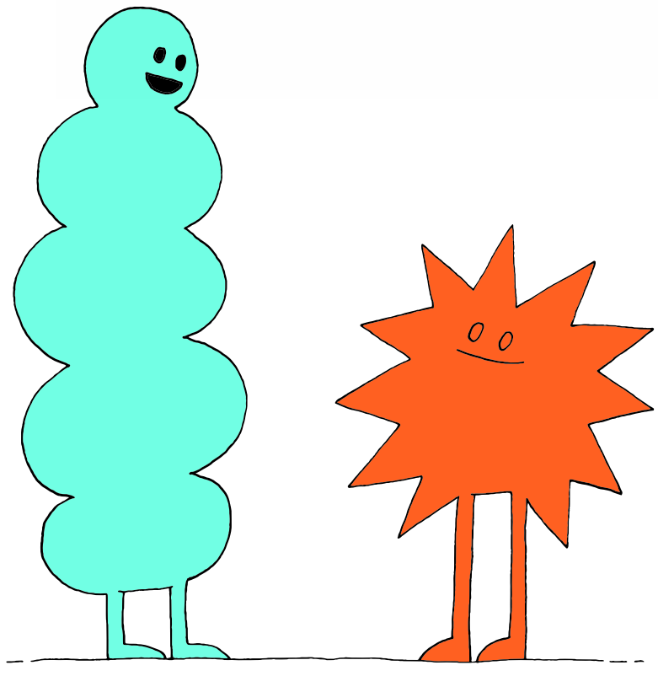
Partner Action Plan
Think-Pair-Share
How can we act with altruism towards the person/people we chose?
Examples: make new student welcome kits, collect food for a food bank

Slide 20
Class Action Plan
Brainstorm:
How can we act with altruism towards the person/people we chose?
Class Choice:
How do we want to show altruism?
Consideration:
Let’s consider taking action anonymously.
How could this add to the primary aspect of altruism (doing something kind with no benefit to oneself)?

Slide 21
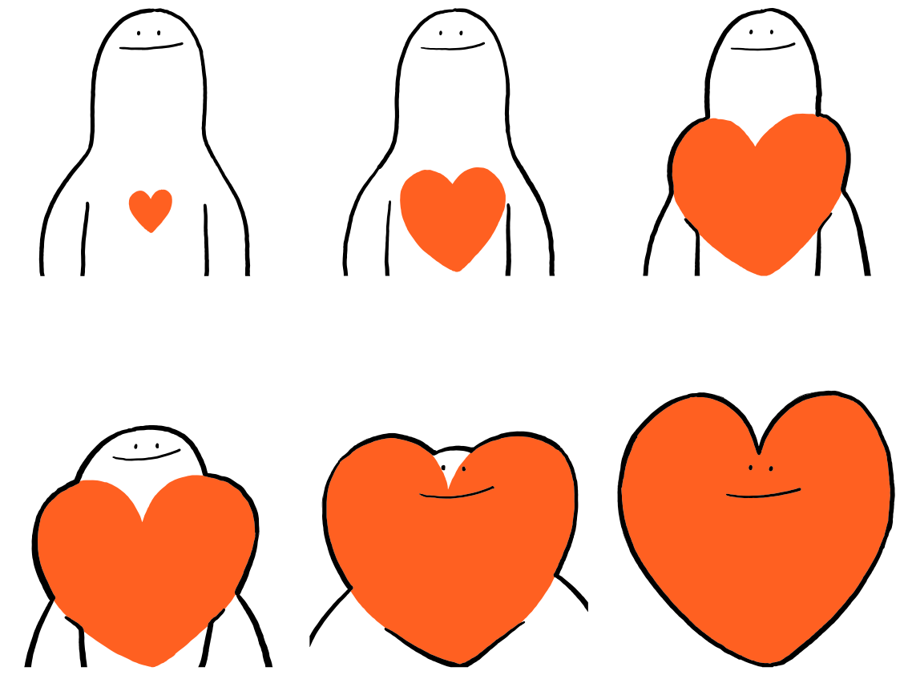

Slide 22
First, find a comfortable seat.
Balloon Breathing
Then, close your eyes or pick a spot on the floor to focus on.
Next, notice what you hear around you.
After you settle into your comfy spot, focus on breathing in through your nose, out through your mouth.
Finally, imagine your belly is a balloon. Fill up nice and round before you exhale. Do this for 2 minutes.

Slide 23
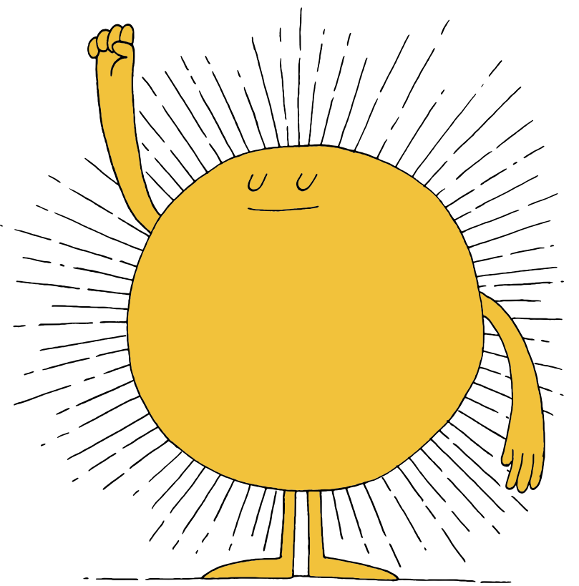
Take Action!
Let's put our altruism plan into action!
Notes:
Teacher Note: Try to keep this activity fun and lighthearted! Practicing altruism should be enjoyable and make you want to practice it more and more!

Slide 24
Altruism Review
noun
Definition: when we care about others and do kind acts that help them even though we don’t get anything in return by doing those acts.
Think-Pair-Share
What does altruism mean to you in your own words?
Why are we practicing altruism?

Slide 26
First, find a comfortable seat.
Balloon Breathing
Then, close your eyes or pick a spot on the floor to focus on.
Next, notice what you hear around you.
After you settle into your comfy spot, focus on breathing in through your nose, out through your mouth.
Finally, imagine your belly is a balloon. Fill up nice and round before you exhale. Do this for 2 minutes.

Slide 27
A Walk Down Memory Lane
Think-Pair-Share
Who did we choose to show altruism to and why?
What was your favourite memory from our altruistic action?
How can you keep showing altruism each day?

Slide 28
Reflection
Independent Writing
Write or draw about your experience with our altruism action.
What did you do?
How did it feel to work together as a class?
How are you feeling now after our work together?
How could acting with altruism impact your own well-being?

Slide 29
Reflection Sheet
Notes:
Teacher Note: A printable version of this sheet can be found in the lesson package

Slide 30
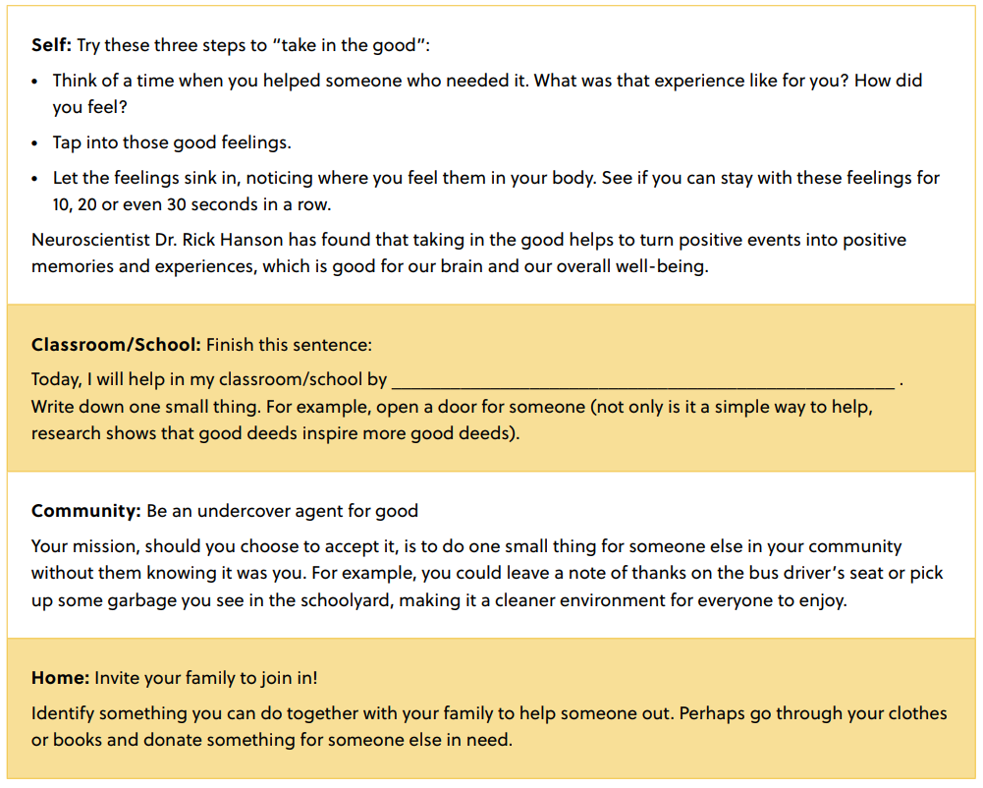
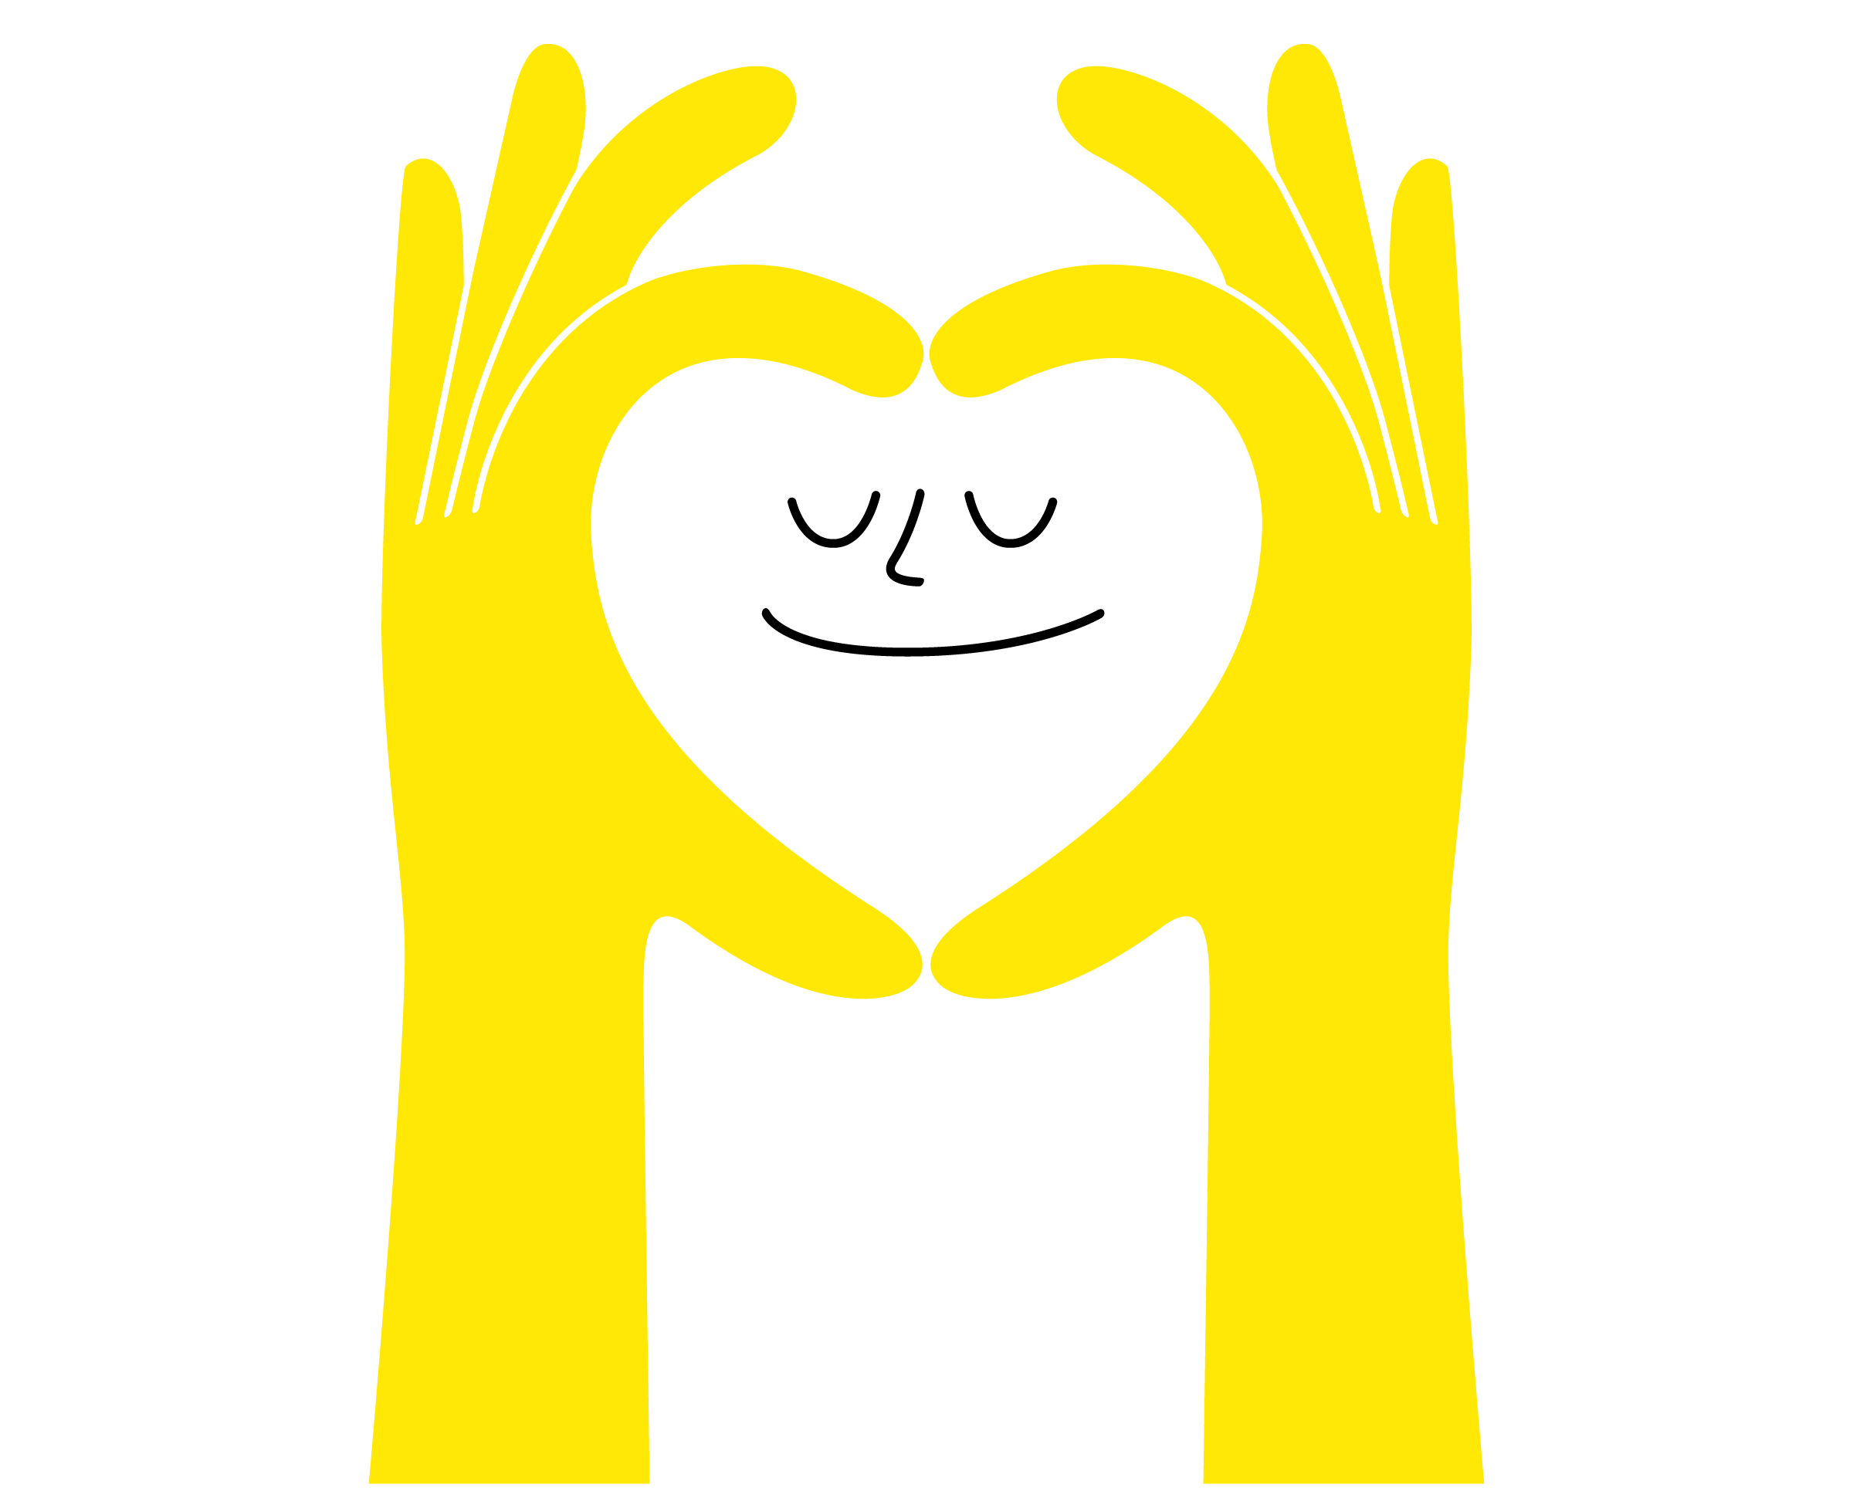
Daily Action

Slide 31
