Slide 1
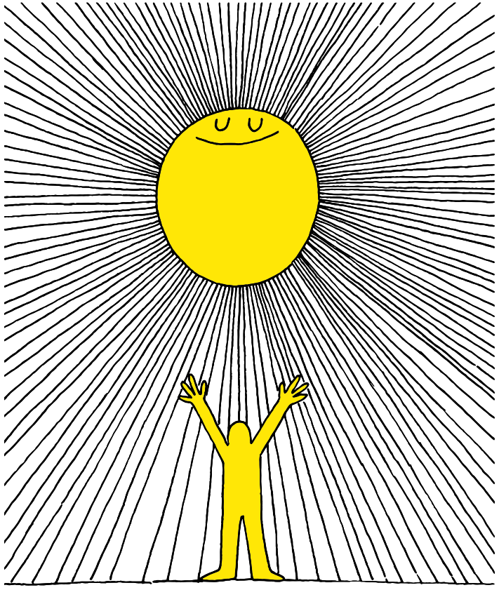

Slide 2
Lesson PowerPoint Table of Contents
Lesson 1: Let’s Get Started
Lesson 2: The Road to Mindfulness
Slides 3-10
What is well-being?
Learning about well-being
Understanding your own well-being
Slides 11-19
What is mindfulness?
Practicing mindfulness
Mindful breathing exercise
Lesson 3: Understanding our Feelings
Lesson 4: Managing our Emotions
Slides 20-27
Reviewing mindfulness
Recognizing feelings
Understanding the effect of our feelings
Slides 28-35
Reviewing mindfulness
Recognizing feelings
Understanding the effect of our feelings

Slide 4
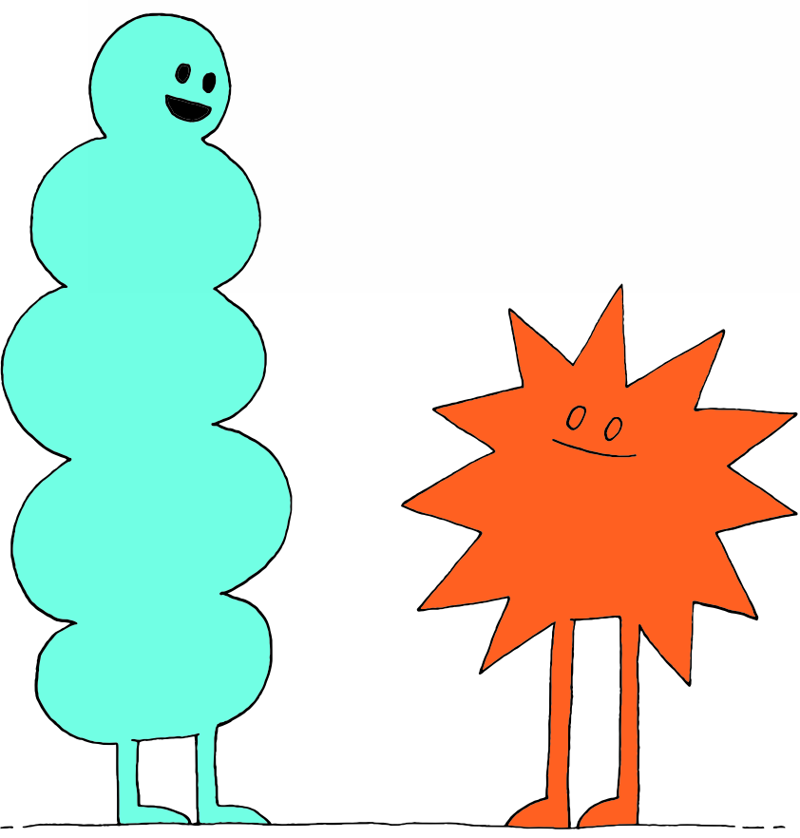
What is “Well-Being”?
noun
Definition: The state of being comfortable, happy, or healthy
Popcorn Thoughts
How does this definition relate to your thoughts about well-being?

Slide 5
Well-Being Continued
noun
Definition: What you feel when you are worried or uncomfortable about something.
Caring for our well-being helps us manage stress and disappointments.
What does managing stress look like for you?
Why is it important?

Slide 6
Who Are We Grateful For?
Brainstorm:
What could you do to increase your well-being?

Slide 7
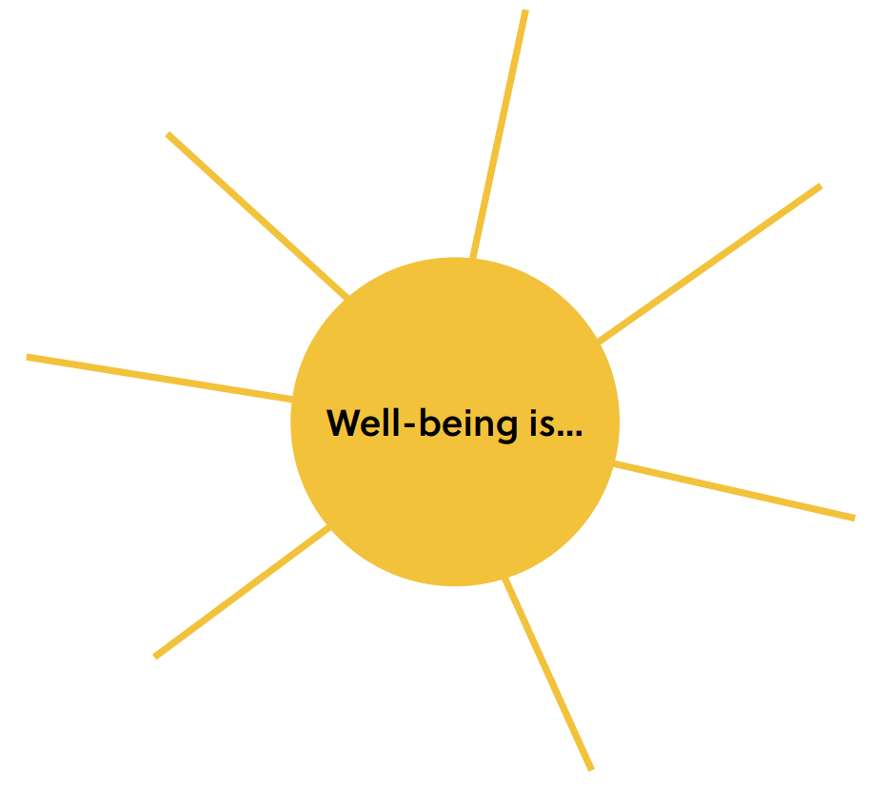
Well-Being is…
What does well-being look like to you?
Notes:
Teacher notes: There is a printable version of this bubble map in our Well-Being Canada resources, so you can…
- Print the web out and have your students complete this independently first
- Print the web out and have students complete in partners or small groups first
- Project the web on your board and complete together as a class
The following slide shows sample answers so your class can compare your answers with ours!

Slide 8
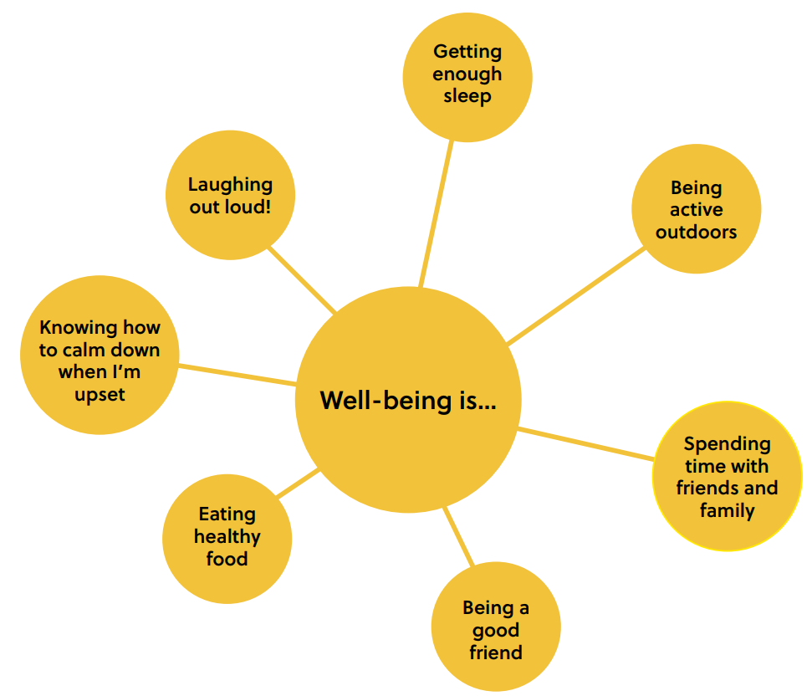
Well-Being is…
See how your answers compare to ours!

Slide 9
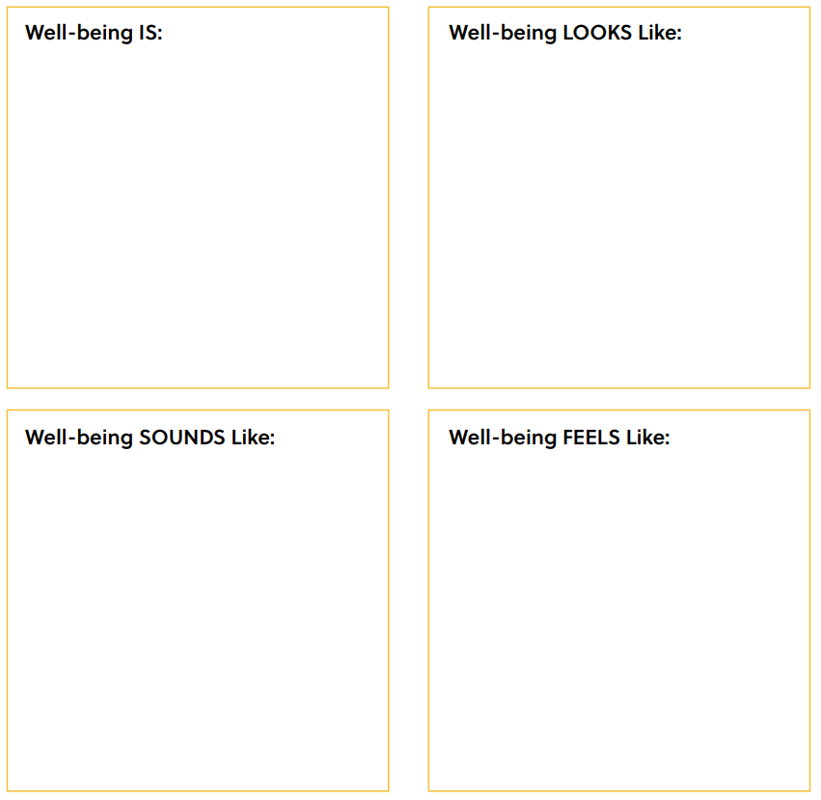
Share Out!
Notes:
Teacher Note: A printable version of this sheet can be found in the lesson package

Slide 10
Notes:
Teacher Note: A printable version of this sheet can be found in the lesson package

Slide 11
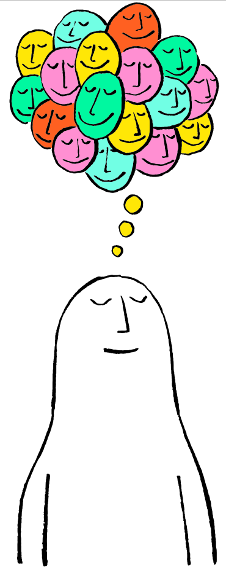

Slide 12
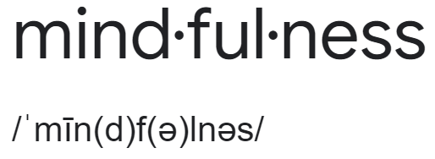
What is Mindfulness?
noun
Definition: Paying full attention to what is happening in the moment, without judgement.
Think-Pair-Share
What do you think it means to pay attention to what is happening in the moment?
What do you think “without judgement” means?

Slide 13
Unpacking Mindfulness
giving your full attention and interest
keeping an open mind about what you are seeing or hearing
the opposite of rushing or multitasking
being curious about the “here and now”
focusing in a relaxed, easy way
Think-Pair-Share
Why do you think practicing mindfulness is good for your well-being?

Slide 14
Let’s Practice!

Slide 15
Tasting with Mindfulness
Today we’re going to taste with mindfulness by focusing our full attention on our food one step at a time.
Put your food in your mouth, but don’t bite yet…
Bite into your food and chew slowly…
Just look at your food…
Just smell your food…
Notice all the different things you see
Notice what you smell
Notice the texture:
Is it rough or smooth?
Notice how it tastes and enjoy thinking about it
Do you see anything you like or don’t like?
What does it smell like?
Does it smell familiar?
Say a quiet “thank you” to everyone who brought this food to you
Can you taste it without biting it?
How do you feel after trying this mindfulness activity?
What did you notice?

Slide 16
Mindful Breathing
Now, we’re going to try a very short exercise that will help us to be mindful and also can be helpful in calming our bodies and minds.

Slide 17
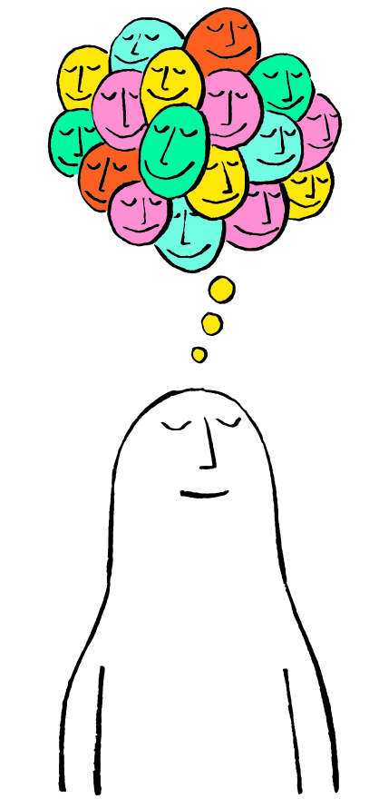
First, find a comfortable seat.
Balloon Breathing
Then, close your eyes or pick a spot on the floor to focus on.
Next, notice what you hear around you.
After you settle into your comfy spot, focus on breathing in through your nose, out through your mouth.
Finally, imagine your belly is a balloon. Fill up nice and round before you exhale. Do this for 2 minutes.

Slide 18
Mindful Breathing
Think-Pair-Share
What did you notice while you were deep belly breathing?

Slide 19
Mindful Practices
Additional Mindfulness Awareness Practices:
Mindful movement
Mindful walking
Mindful in nature
Mindful art
Mindful communication
Think-Pair-Share
What do you think these mindful awareness practices are like?

Slide 20
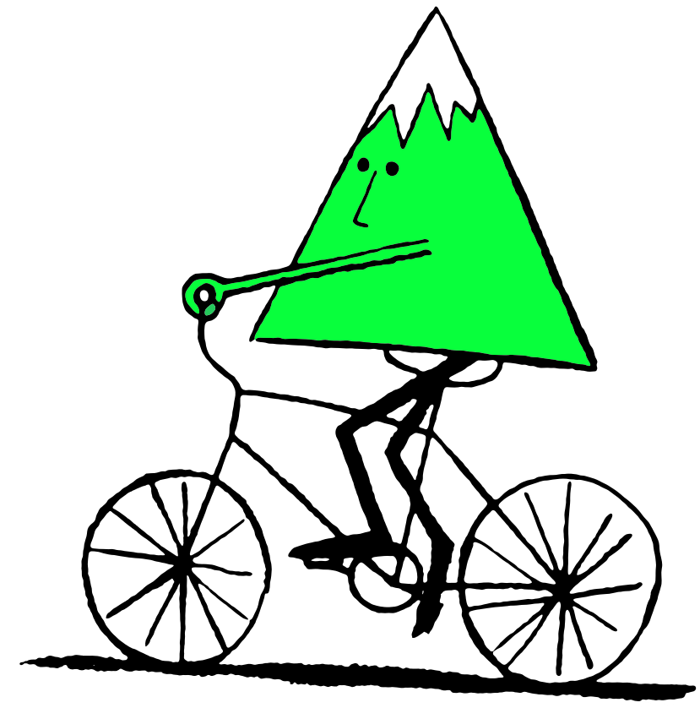

Slide 21
Review
Think-Pair-Share
What is well-being?
What is mindfulness?

Slide 22
First, find a comfortable seat.
Balloon Breathing
Then, close your eyes or pick a spot on the floor to focus on.
Next, notice what you hear around you.
After you settle into your comfy spot, focus on breathing in through your nose, out through your mouth.
Finally, imagine your belly is a balloon. Fill up nice and round before you exhale. Do this for 2 minutes.

Slide 23
Feelings and Well-Being
Today’s topic is understanding our feelings.
Popcorn Thoughts
How do you think understanding our feelings contributes to our well-being?

Slide 24
What are Intentions?
Let’s compare/contrast a goal vs intention…
noun
Definition: Something you are trying to do or achieve.
noun
Definition: A determination to act in a certain way.

Slide 25
Goals vs Intentions
Goals
Intentions
Final achievement or destination
“External”
Something you want to attain in the future
Something you plan to do regardless of the outcome
More about your attitude
Focused on the present
The “how” you do something
Examples:
Examples:
Being kind to others
Being patient with your sibling
Listening to other’s point of view
Getting an A in math
Learning a new skateboard trick

Slide 26
Intentions Definition
Here’s the dictionary definition again…
noun
Definition: A determination to act in a certain way.
Think-Pair-Share
What would your definition of intentions be?

Slide 27
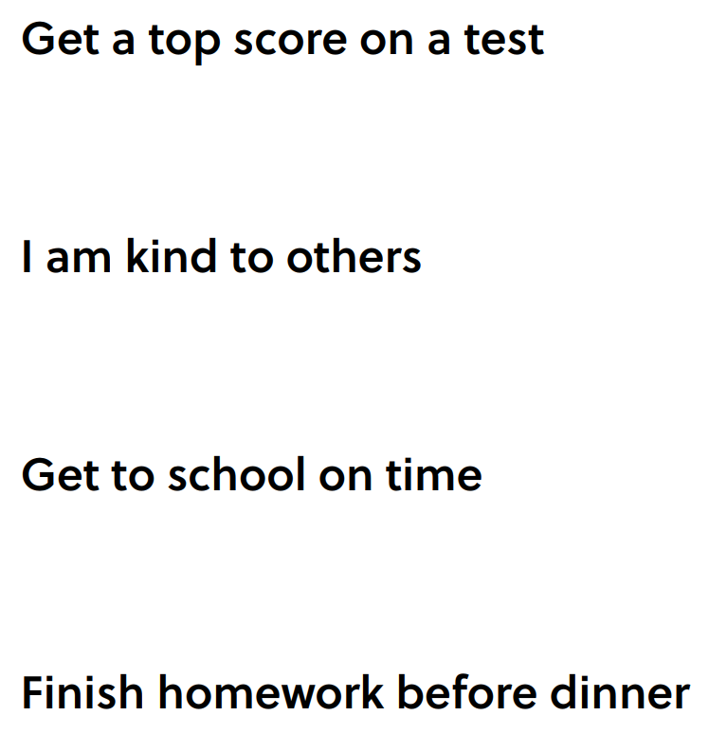
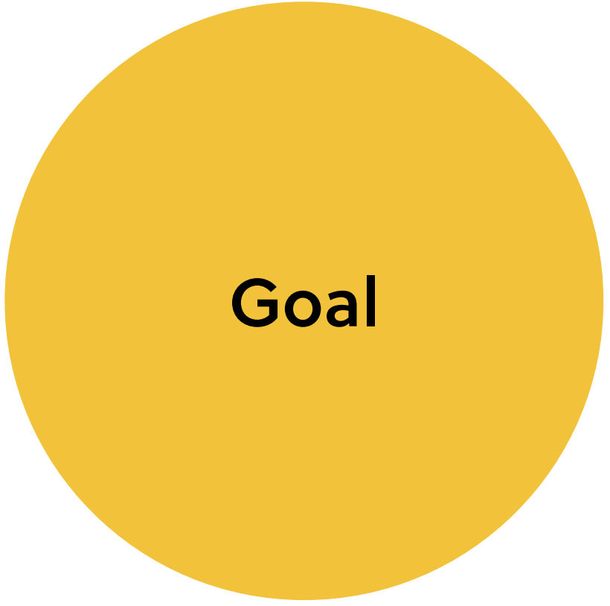
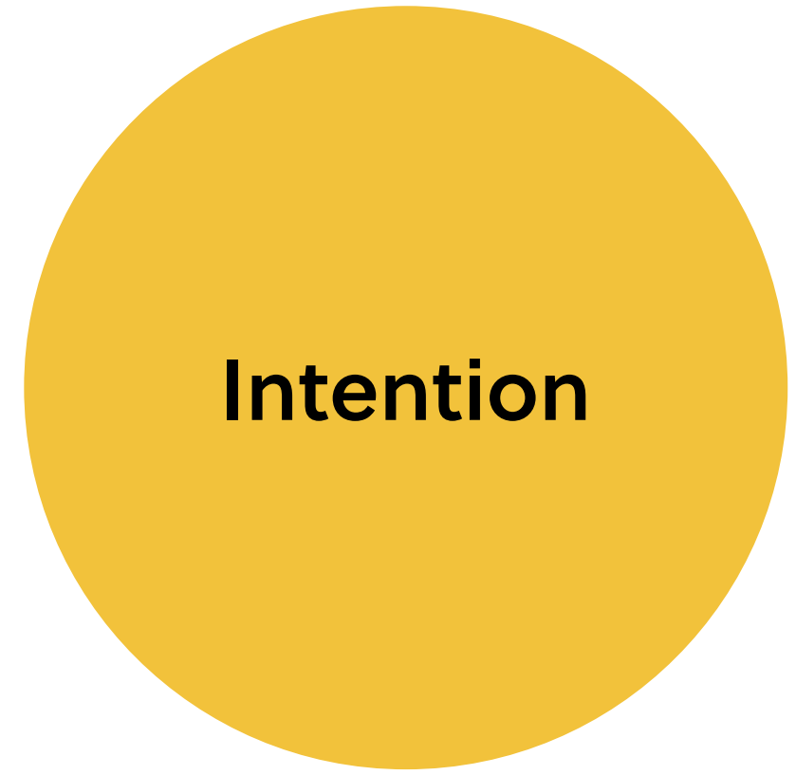
Goal or Intention Match Game
Notes:
Teacher Note: A printable version of this sheet can be found in the lesson package

Slide 28
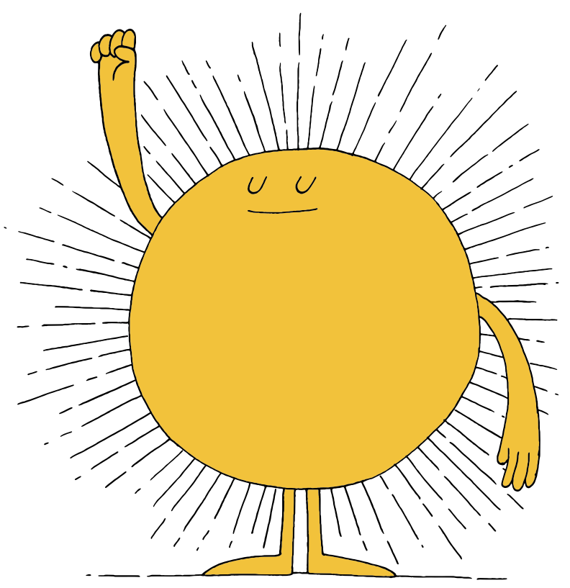

Slide 29
First, find a comfortable seat.
Balloon Breathing
Then, close your eyes or pick a spot on the floor to focus on.
Next, notice what you hear around you.
After you settle into your comfy spot, focus on breathing in through your nose, out through your mouth.
Finally, imagine your belly is a balloon. Fill up nice and round before you exhale. Do this for 2 minutes.

Slide 30
Intention Setting Visualization
Closing your eyes (if you’re comfortable), think to yourself…
When are you your truest, best self?
What does it look like, sound like, and feel like?
Hold that image of yourself in your mind
When you’re ready, open your eyes.

Slide 31
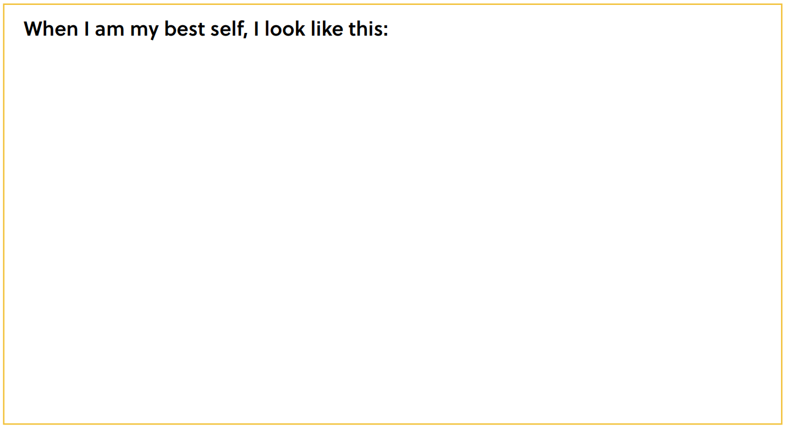
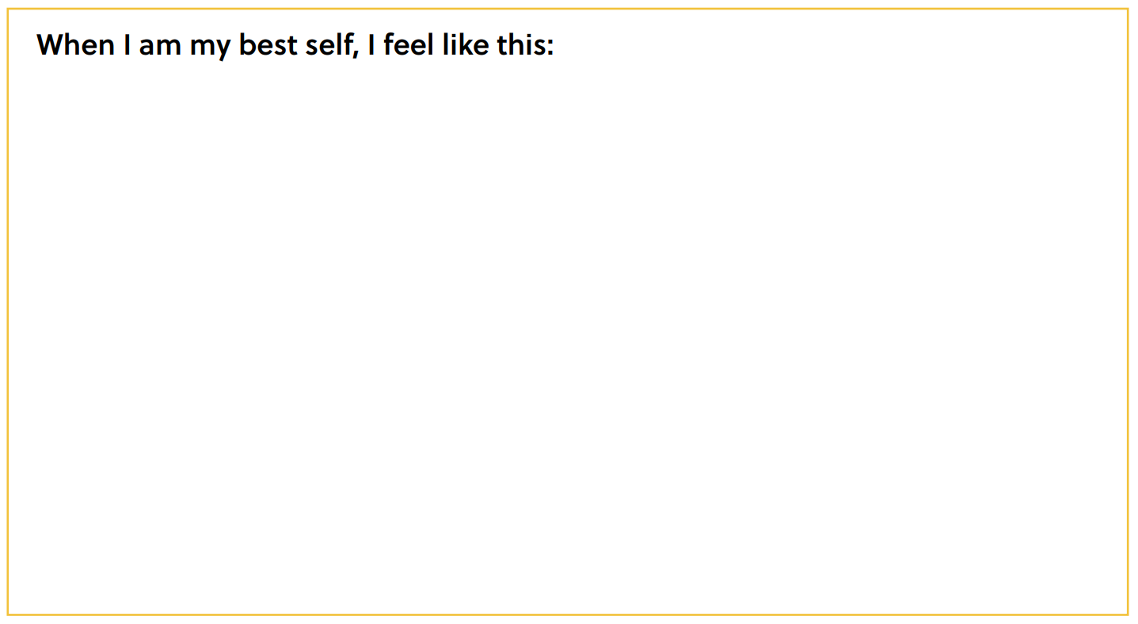
My Best Self
Notes:
Teacher Note: A printable version of this sheet can be found in the lesson package

Slide 32
Definitions Recap
Well-being: The state of being comfortable, healthy or
happy.
Mindfulness: To pay attention to what is happening in
the moment, without judgment.
Goal: Something that you are trying to achieve.
Intention: A determination to act in a certain way.

Slide 33
Prepare to Set Intentions
Example: I feel happy when I play my favourite sport.
Intentions:
Make an effort to find time to play
Instead of watching TV, go outside
Notice how you feel when you play
Be mindful when you play
Example: I am my best self when I’m a good friend.
Intentions:
Be kind
Let go of grudges
Include others
Help others feel part of a community

Slide 34
Creating a Personal Plan
Independent Writing
Describe an intention for today that helps you be your best self.

Slide 35
Share out!
If you are comfortable, share your intention for today.

Slide 36
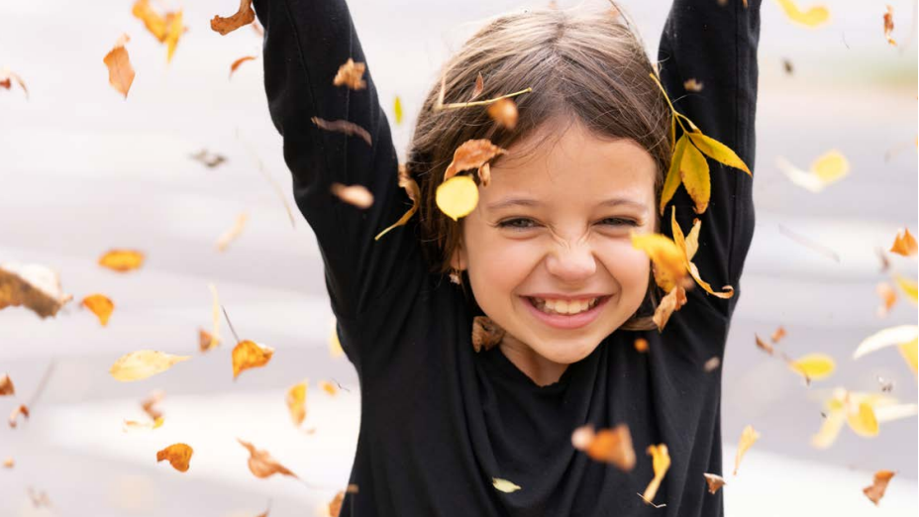
Thank you!

